Slide 1
An ET tube to far… Respiratory support in non-intubated child with respiratory failure
PEM ECHO Conference Series
February 14th 2019
Ric Pierce
Assistant Professor or Pediatrics
Yale School of Medicine
Section of Pediatric Critical Care Medicine

Slide 2
Disclosures
I have no relevant financial interests to disclose

Slide 3
Learning objectives
Understand the physiologic benefits and practical applications of heated humidified high flow nasal cannula in children (HFNC)
Understand the physiologic benefits and practical applications of continuous or bilevel pressure support in children (CPAP or BiPAP)
Understand the indications, benefits and risks of applying HFNC, CPAP or BiPAP to critically ill children with respiratory failure
Case Discussions

Slide 4
Spectrum of respiratory support in critically ill children
Room Air
NC
Face mask
HHHFNC
CPAP
BiPAP
Conventional
Ventilation
APRV
Modalities that modulate flow
HFOV
Modalities that modulate pressure
ECMO

Slide 5
Indications for escalation of respiratory support
Oxygenation failure
SpO₂ <90%, PaO₂ < 60 mmHg, PaO₂/FiO₂ < 300
Ventilation failure
PaCO₂ > 45 mmHg and pH < 7.35
Both
Apnea, upper airway obstruction, pneumonia, altered mental status, cardiopulmonary collapse

Slide 6
Oxygen delivered for common flow devices
Device | Flow | % FiO2
Nasal cannula | 1 LPM off the wall | 24
 | 2 | 28
 | 3 | 32
 | 4 | 36
Simple face mask | 5 to 6 | 40
 | 6 to 8 | 50
Face mask with reservoir bag | 6 | 60
 | > 8 | 80
HHHFNC | Infant: 4 to 20 LPM | 21-100
 | Child: 5 to 40 LPM | 21-100
 | Adolescent: 5 to 80 LPM | 21-100
Notes:
Oxygen flow should be turned up all the way in the setting of acute decompensations

Slide 7
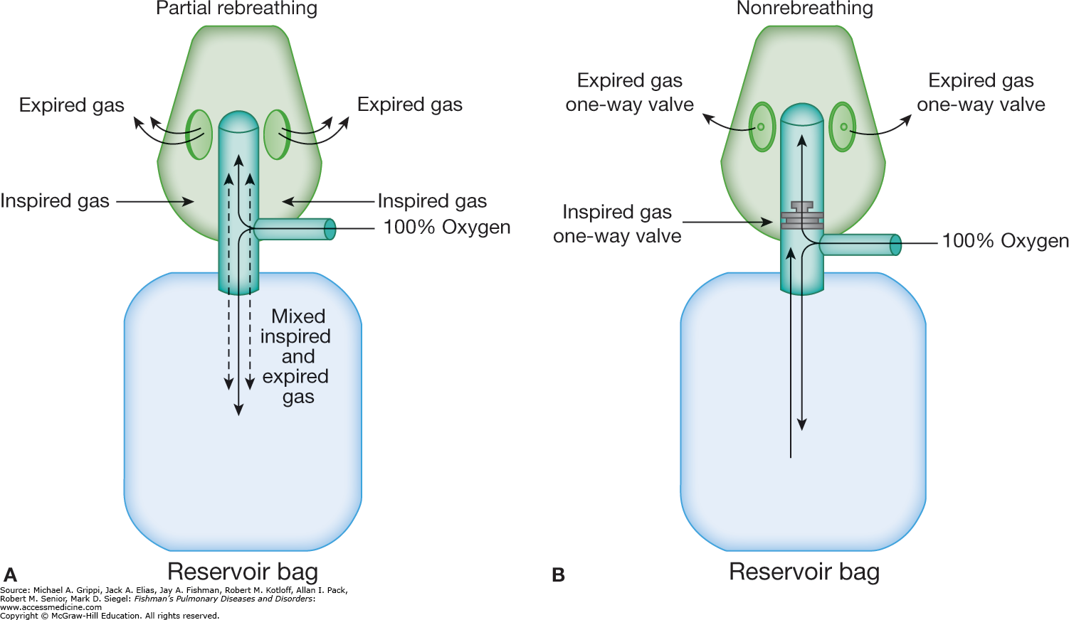
“Non-rebreather” mask
Notes:
Non-rebreather masks don’t really exist because the patient could suffocate if oxygen flow is interrupted
We use simple masks and rebreathing reservoir masks that don’t deliver as much O2

Slide 8
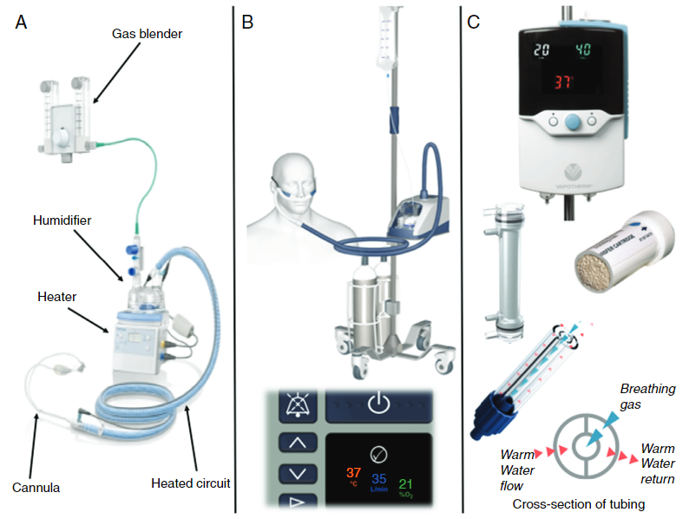
MacGyver
Setup
Airvo 2
Precision
Flow
Notes:
HFNC: Typically defined as flow > 4 LPM
Infants 5 to 20 LPM, adults may go up to 80 LPM
Oxygen is blended, from 21 to 100%
Contraindications to HFNC include abnormalities of the face or airway that preclude an appropriate-fitting nasal cannula. Relative contraindications include confusion or agitation, vomiting, excessive secretions, and bowel obstruction. In an observational study, nonresponse to HFNC was been associated with lower pretherapy pH and higher pretherapy PCO₂, highlighting the importance of early initiation
Complications of HFNC include abdominal distension, aspiration, barotrauma, and pneumothorax (rare). However, the risk of pneumothorax is lower with HFNC than with mechanical ventilation following endotracheal intubation

Slide 9
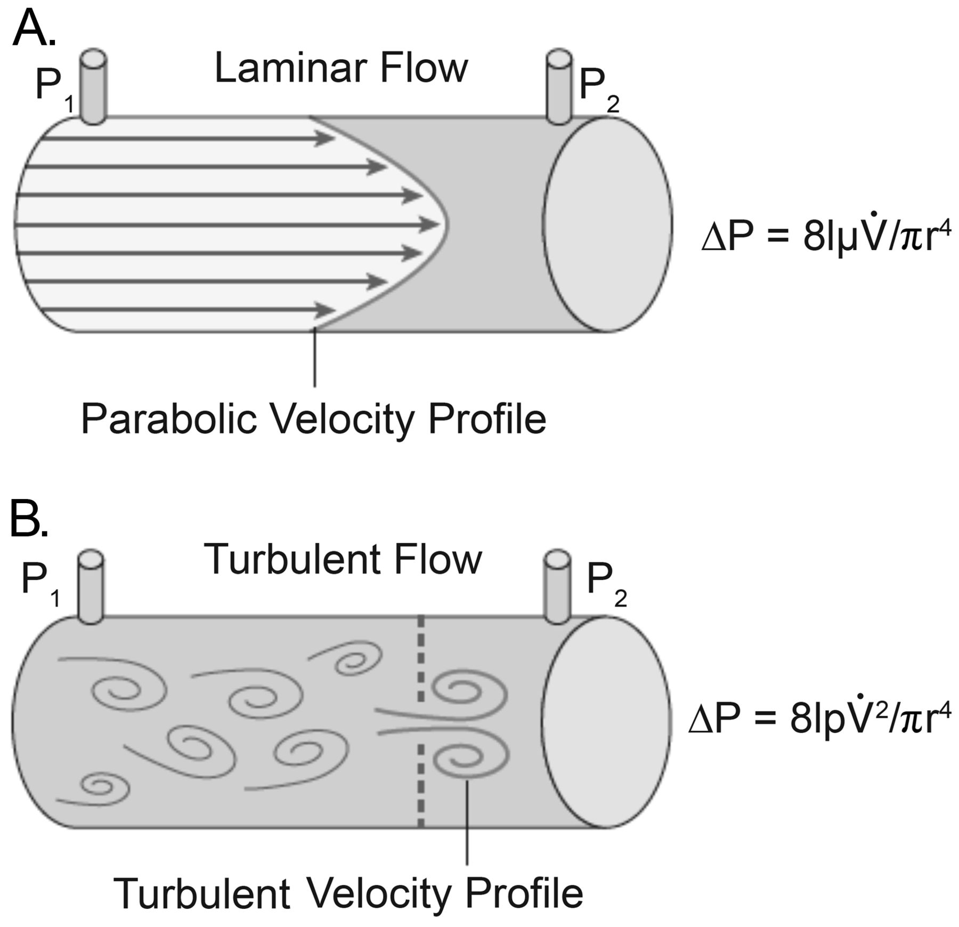
How does HHHFNC provide respiratory support?
1.
2.
3.
4.
5.
Magical properties of pre-
heated and humidified gas
Notes:
Improvement of airway conductance and pulmonary compliance by reducing the effect of cold air; an in vitro study has shown that inspired gas with low humidity even for short periods may result in worsened function of human airway epithelial cells inflammatory indices along with reduction of the metabolic cost of gas conditions by providing air with 100 % relative humidity

Slide 10
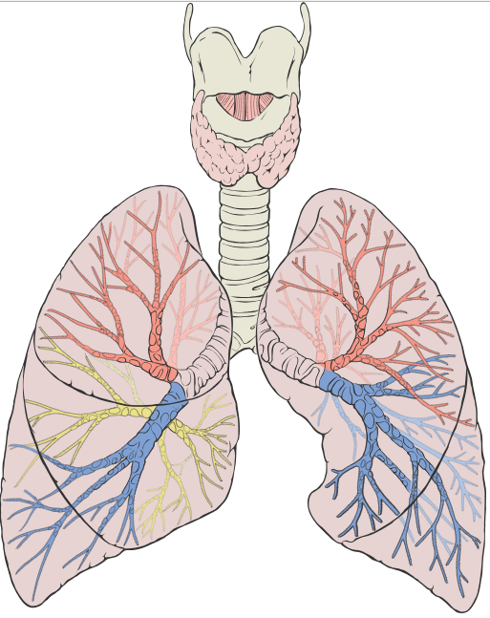
How does HHHFNC provide respiratory support?
1.
2.
3.
4. Small and variable about of lower airway pressure (PEEP)
5. Magical properties of pre-heated and humidified gas
Notes:
Small and variable amount of positive end-expiratory pressure in the lower airways
More significant at higher flow rates with less respiratory effort
Probably not super helpful, especially in the acute setting

Slide 11
How does HHHFNC provide respiratory support?
1.
2.
3. Decreased resistance to flow in the upper airways
4. Small and variable about of lower airway pressure (PEEP)
5. Magical properties of pre-heated and humidified gas
Notes:
Constant distending flow of the upper airways decreased resistance to inspiratory flow
Up to 50% of total airway resistance in infants is from the upper airway, more if nasal congestion is present
Immediate benefit in WOB

Slide 12
How does HHHFNC provide respiratory support?
1.
2. Increased FiO₂
3. Decreased resistance to flow in the upper airways
4. Small and variable about of lower airway pressure (PEEP)
5. Magical properties of pre-heated and humidified gas
Notes:
Increase FiO2 due to decreased entrainment of ambient air
At higher flow rates FiO2 may match set FiO2
Infants peak inspiratory flow may be between 8 and 12 LPM
Immediate benefit to oxygenation

Slide 13
How does HHHFNC provide respiratory support?
1. Conditioning of nasopharyngeal dead-space gas
2. Increased FiO₂
3. Decreased resistance to flow in the upper airways
4. Small and variable about of lower airway pressure (PEEP)
5. Magical properties of pre-heated and humidified gas
Notes:
Constant flow replaced naso-pharyngeal deadspace gas with high O2 low CO2 gas
Effectively decreases anatomic deadspace, making every breath more efficient
Immediate benefit for ventilation

Slide 14
How effect is HHHFNC in children?
Multiple studies have demonstrated safety
Many small studies comparing “efficacy” to “standard of care”
How to compare HFNC to low flow NC or CPAP?
L/min? L/kg/min? L/kg?
May decrease intubation rates (McKiernan, 2010 & Wing 2012)
Or not (Riese, 2012, Metge 2014, Essouri 2017)
Generally, success or failure is evident by the first hour
Notes:
Most studies compare efficacy to some clinical outcome: RR, WOB, SaO2
McKiernan: retrospective observational cohort of 115 bronchilitics in PICU, intubated decreased from 23 to 9%
Wing: Retrospective case control: 848 PICU pts intubation rate decreased from 23 to 8%
Riese: 120 bronchiolitics in PICU (CPAP available): PICU LOS less by 1 day
Metge: 34 bronchiolitics in PICU (CPAP available): no changes in any parameters
Infants receiving HFNC who are clinically deteriorating may develop significant respiratory acidosis (hypercapnia) despite high oxygen saturations (if they are receiving supplemental O₂). Oxygen saturation is a poor indicator of impending respiratory failure, which is better indicated by marked retractions, decreased or absent breath sounds, fatigue, and poor responsiveness to stimulation (eg, weak or no cry). Blood gas analysis to assess ventilation (ie, PCO₂ levels) may be warranted in infants receiving HFNC who become more dyspneic and/or tachycardic

Slide 15
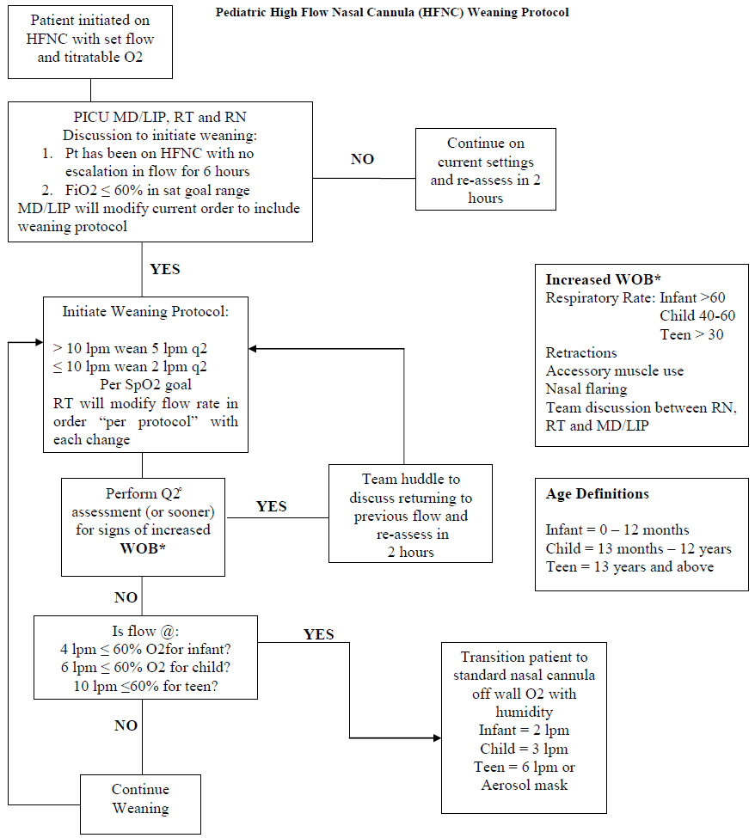
Humidified High Flow Nasal Cannula
Notes:
Yale New Haven Children’s Hospital PICU protocol for weaning of HFNC

Slide 16
Continuous & Bilevel Positive Airway Pressure
Fixed pressures with variable flow
Continuous pressure (CPAP) or variable bilevel pressure (BiPAP)
CPAP: 5 to 12 cmH₂O, 21 to 100% FiO₂
BiPAP: 12/5 to 20/10, 21 to 100% FiO₂
Synchronous or asynchronous
May allow for monitoring: Tidal volume or ETCO₂
May require corporation/sedation
Multiple patient-machine interfaces

Slide 17
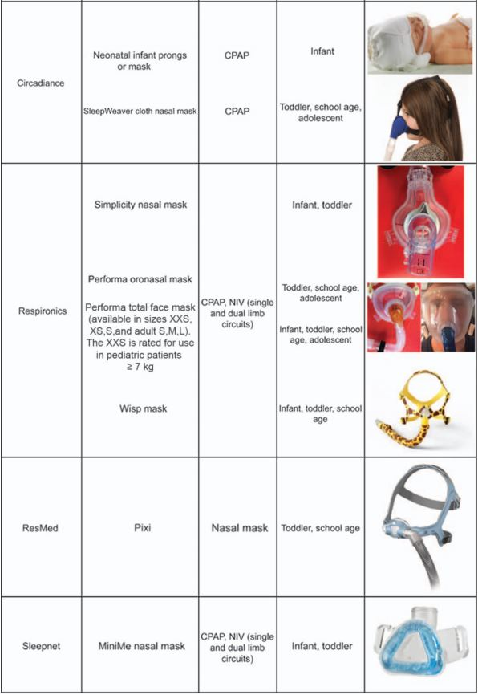
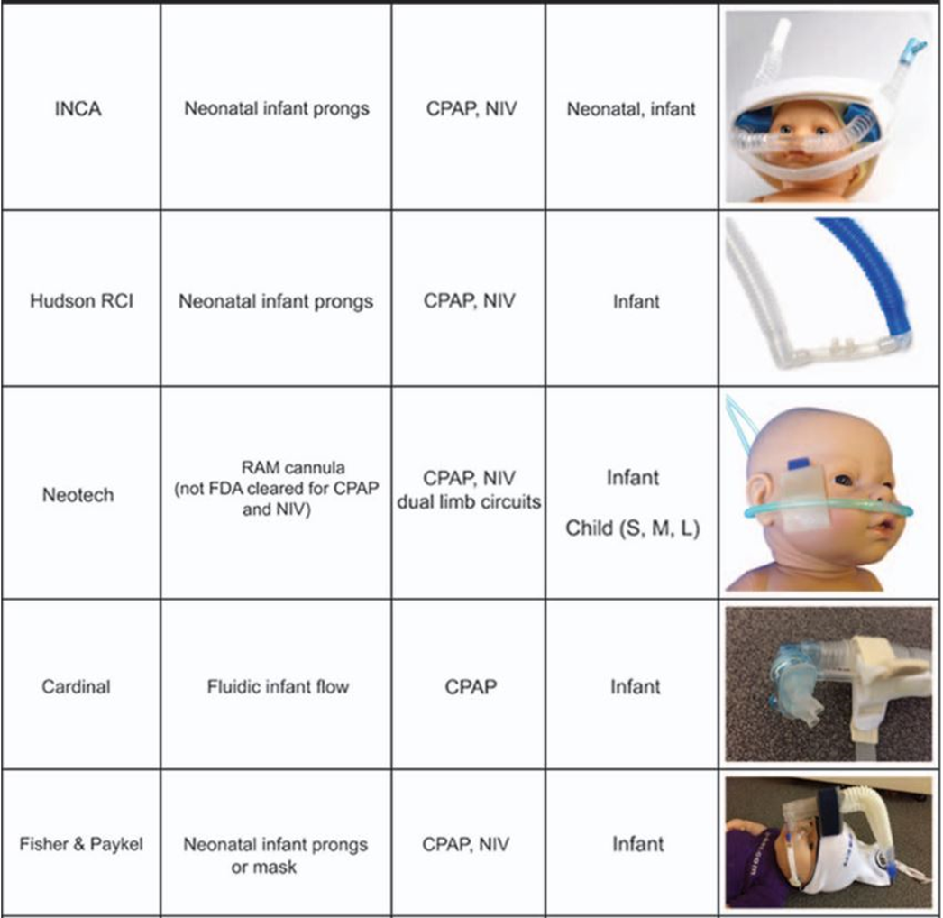
RESPIRATORY CARE • JUNE 2017 VOL 62 NO 6

Slide 18
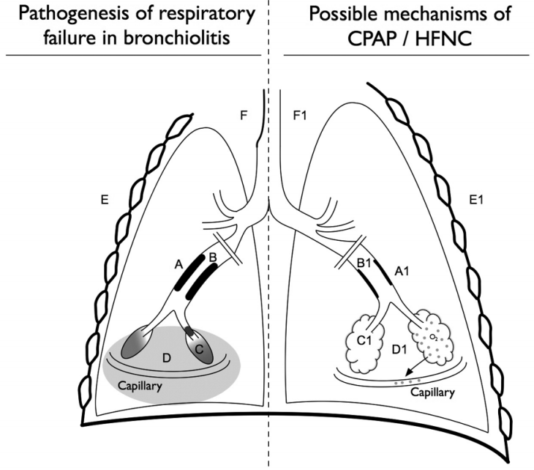
Continuous & Bilevel Positive Airway Pressure
A: Airway obstruction
B: Intraluminal mucus
C: Atelectasis
D: Interstitial edema
E: Respiratory muscle fatigue
F: Upper airway collapse
Sinha et. al., Chest 2015
Notes:
BiPAP adds increased distending pressure during inspiration
NIPPV is asynchronous BiPAP for babies
Many different patient-machine interfaces, work with respiratory to optimize

Slide 19
HHHFNC
Variability in PEEP or FiO₂
Easy to apply
Minimal sedation required
Increased institutional comfort
May allow feeding
Better secretion management
CPAP or BiPAP
Tight control of PEEP or FiO₂
Interface may be challenging
Requires cooperation/sedation
PICU monitoring
Generally NPO
May insufflate stomach
May allow for V_{T} or ETCO₂
Both modalities are available on transport

Slide 20
Thank you and on to the cases!

