Slide 1
PEM ECHO SERIES
Building a Community of Practice
PEM Team – Drs. Auerbach, Garcia, Goldman, Gross, Woll and Tiyyagura
Today’s Featured Speaker:
David Stitelman, M.D.
Assistant Professor of Surgery
Yale University School of Medicine
December 13th, 2018

Slide 2

Theory
Moving Knowledge, Not Participants
  Through technology-enabled collaborative learning, ECHO creates access to pediatric emergency medicine education and resources for community ED providers.
Bidirectional Learning Model
  Learn from experts in the field
  Learn from each other
  Pediatric experts learn from community providers!

Slide 3
The ECHO Goal = "Community of Practice”

Slide 4
PEM ECHO Course Outline -
Dec. 13th - Abdominal Workups - Dr. David Stitelman
Jan. 10th - Bronchiolitis - Dr. Michael Goldman
Feb. 14th - Vent Management - Dr. Ric Pierce
Mar. 14th - Febrile Infants - Dr. Paul Aronson
Apr. 11th - Airway/RSI - Dr. Joshua Nagler
May 9th - Seizures - Dr. Niyati Mehta
More Dates And Topics TBD

Slide 5
Today’s Outline
Dr. David Stitelman – Expert Guest Speaker – Pediatric Surgeon
  Diagnosis and Management of Pediatric Appendicitis
Drs. Chris Woll and Michael Goldman from Greenwich Hospital
  Cases from a Community Hospital
Drs. Stitelman and Goldman –
  Moderated discussions
  Diagnostic and logistical challenges for the community hospital team

Slide 6
ECHO Rounds #1
Diagnosis and Management of Appendicitis
David Stitelman, M.D.
Assistant Professor of Surgery
Yale University School of Medicine
April 2, 2015

Slide 7
Disclosure
David Stitelman, M.D.
I have no relevant financial relationships with the manufacturer(s) of any commercial product(s) and or provider of commercial services discussed in this presentation

Slide 8
Objectives
By the end of this ECHO, participants will be able to:
Review and critique the current recommendations for pediatric appendicitis workups
Engage in discussion around diagnostic and logistical challenges, specifically facing the community hospital team

Slide 9
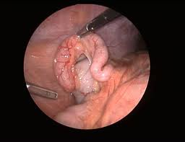
Overview
Background
Diagnostic Approach
The Then What?
--CT Scan,
--Observe,
--Transfer

Slide 10
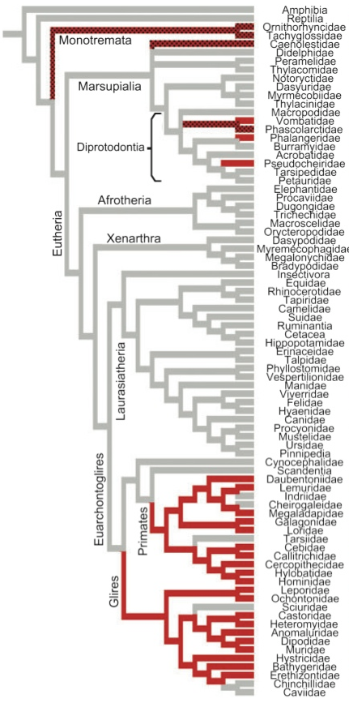
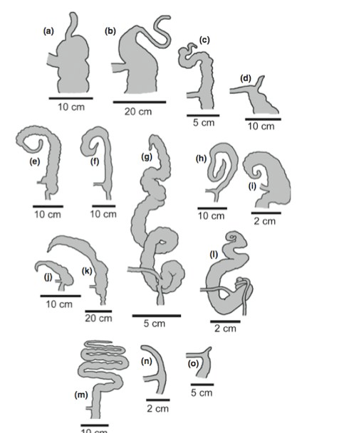

What does the appendix do?
Orangutan
Human
Squirrel
Anteater
Koala
Notes:
A Human
B Oragutang
C Lemur
D Wombat
E Rabbbit
F Cuscus
G Squirel
H Possum
I Mole-Rat
J Porcupine
K beaver
L Medow Vole
M Koala
N Platypus
O Echidna (Anteater)

Slide 11
Appendicitis--Some Numbers
Lifetime Incidence 6-9%
Most frequently 10 – 20 years of age
Younger children have a greater frequency of perforation (40%)
30% Misdiagnosed initially
Notes:
Underdeveloped omentum

Slide 12
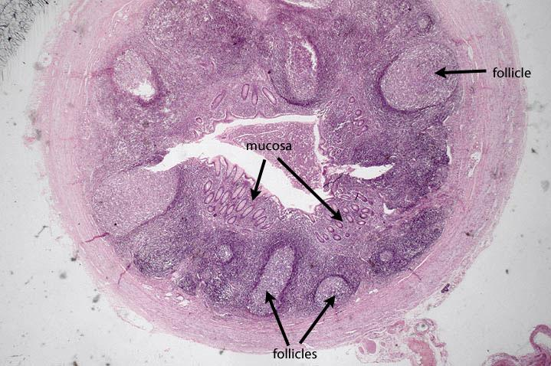
Pathophysiology
Lymphoid Hyperplasia causes luminal obstruction
Blocked appendix secretes mucus and distends
Bacteria multiply
Mucosal bacterial invasion
Distention compromises venous flow
Trans-mural Inflammation sets in.
Necrosis (gangrene) follows
Perforation is a 36-48 hour event

Slide 13

Classical Clinical Presentation
Peri-umbilical Pain
Anorexia/Emesis
Migration of Pain to RLQ (24h)
RLQ Tenderness
Fever

Slide 14
The Problem Under 5
Up to 75% incidence of perforation!
Frequency of “Tummy Aches”
Communication issues
Immature Omentum
Lack of Pain Migration in 50%
Lack of Anorexia in 40%
No Rebound Tenderness 50%

Slide 15
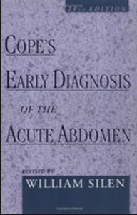
Physical Exam
Pain Medication?
Rectal Exam?

Slide 16
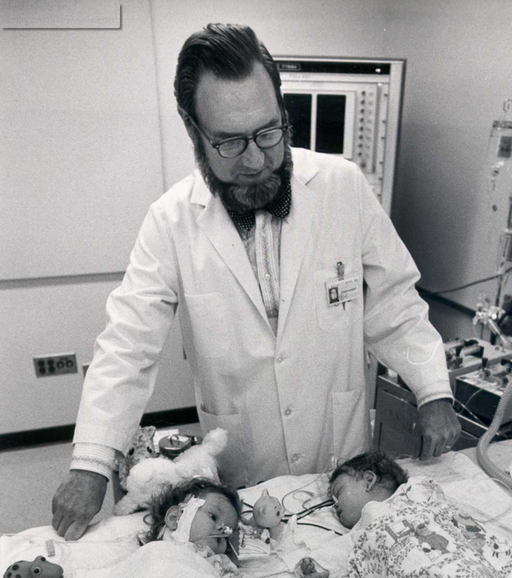
Diagnostic process
Around 80-85% accuracy of diagnosis based on history and physical exam
Appendicitis
20%
80%
85%
15%
Normal Appendix

Slide 17
Use of Biomarkers
WBC and ANC
  Need to know duration of symptoms.
  Can be elevated in other inflammatory processes.
  Symptoms <24h and Pain (Then subsequent surgery)
  WBC > 14.6 80% Sensitive 85% Specific
  WBC < 9 95% Had a normal appendix
WBC 14.6
Appendicitis
20%
80%
85%
15%
Normal Appendix
Notes:
Kwan et al
847 Patients retrospectively

Slide 18
Use of Biomarkers
CRP
  Symptoms <24h and Pain (Then subsequent surgery)
  CRP >1 58-93% Sensitive 28-82% Specific
Notes:
Kwan et al
847 Patients retrospectively

Slide 19
Clinical Scoring Systems
Designed as a system to increase the likelihood of the diagnosis of appendicitis
Alvarado System and the Pediatric Appendicitis Score

Slide 20
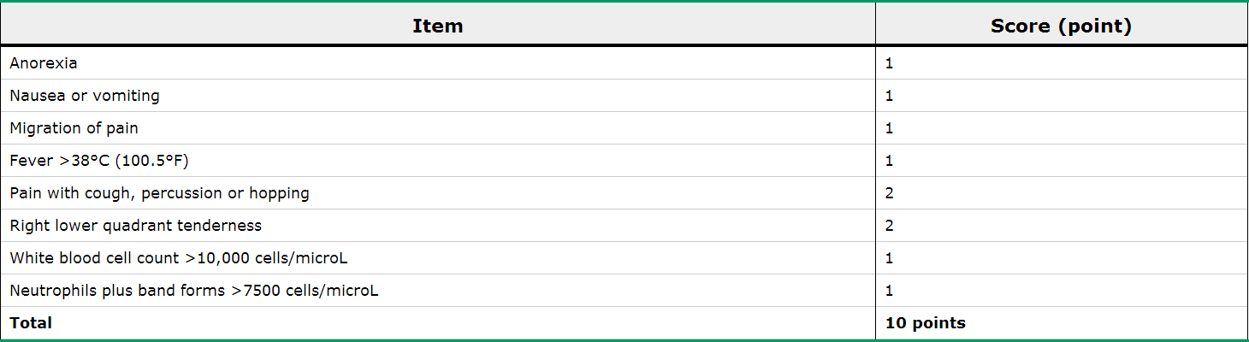
Pediatric Appendicitis Score
1,170 children from the Great Ormond Street Hospital in London

Slide 21
Pediatric Appendicitis Score
Retrospective analysis of the PAS yielded very high sensitivity, specificity and positive predictive values
Prospective evaluations show sensitivity and specificity of 88% and 50% respectively when using a cutoff of 6 for the PAS score
Has less validity in younger children and females
PAS of 6
Appendicitis
12%
88%
50%
50%
Normal Appendix

Slide 22
Clinical Usage of Pediatric Appendicitis Score
Score < 4 Discharge
Score 5-7 Consider diagnostic imaging
Score > 8 Operation
Notes:
A previously healthy 15 year old girl with periumbilical pain followed by emesis and persistent nausea.
The pain migrated to the right lower quadrant where she has pain.
Tm 101.3 Tender to percussion RLQ. WBC count 13 (ANC 8000)

Slide 23
Clinical Usage of Pediatric Appendicitis Score
Score < 4 Discharge
Score 5-7 Consider imaging
Score > 8 Operation
Previously healthy 15 year old girl with
Peri-umbilical pain followed by emesis &
persistent nausea.
Pain migrated to the RLQ
Tm 101.3 Tender to percussion RLQ.
WBC 13 (ANC 8000) HCG Negative
Tally
1
2
3
8
10
Notes:
A previously healthy 15 year old girl with periumbilical pain followed by emesis and persistent nausea.
The pain migrated to the right lower quadrant where she has pain.
Tm 101.3 Tender to percussion RLQ. WBC count 13 (ANC 8000)

Slide 24
Clinical Usage of Pediatric Appendicitis Score
Score < 4 Discharge
Score 5-7 Consider imaging
Score > 8 Operation
Previously healthy 15 year old girl with
Peri-umbilical pain followed by emesis
Now she is hungry.
Pain migrated to the RLQ
Tm 99.9 Tender to deep palpation RLQ.
WBC 13 (ANC 8000) HCG Negative
Tally
1
1
2
4
6
Notes:
A previously healthy 15 year old girl with periumbilical pain followed by emesis and persistent nausea.
The pain migrated to the right lower quadrant where she has pain.
Tm 101.3 Tender to percussion RLQ. WBC count 13 (ANC 8000)

Slide 25
Diagnostic Testing
The appropriate application of diagnostic studies is to:
1. Reduce the rate of negative appendectomy
2. Help identify complicated appendicitis?
3. Identify alternative pathologies that may be confused with appendicitis and may need surgical treatment (perforated Meckel’s diverticulum, ovarian torsion, Crohn’s disease)

Slide 26
Time
Onset
Peri-umbilical Pain
Anorexia/Emesis
Migration of Pain to RLQ
RLQ Tenderness
Fever/Worsening Pain
Perforation
24 hours
48 hours

Slide 27
Ultrasound
Advantages
No need for sedation
No ionizing radiation – can be repeated
Noninvasive (~100% of cases at Yale)
Can be performed by non-radiologists (i.e. technicians)
Can provide information regarding the adnexa in girls
Can identify abscess in complicated appendicitis
Disadvantages
Operator dependent
Exam may be limited in obese children

Slide 28
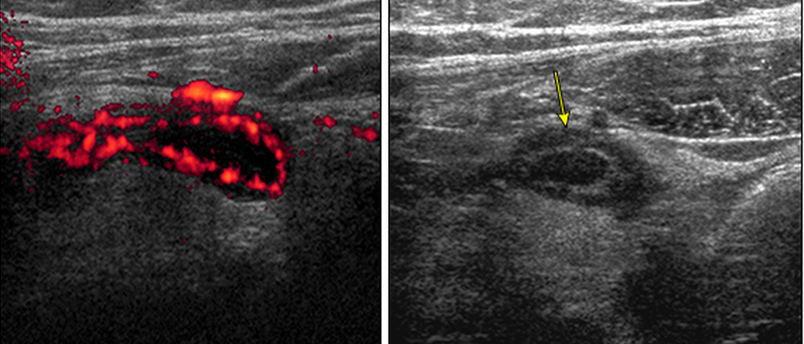
Ultrasound
Acute appendicitis =noncompressible, tenderness, hyperemic & thickened (>6-7 mm)(>2mm wall thickness), Mesenteric Thickening
Notes:
Acad Emerg Med. 2013 Jul;20(7):697-702.

Slide 29
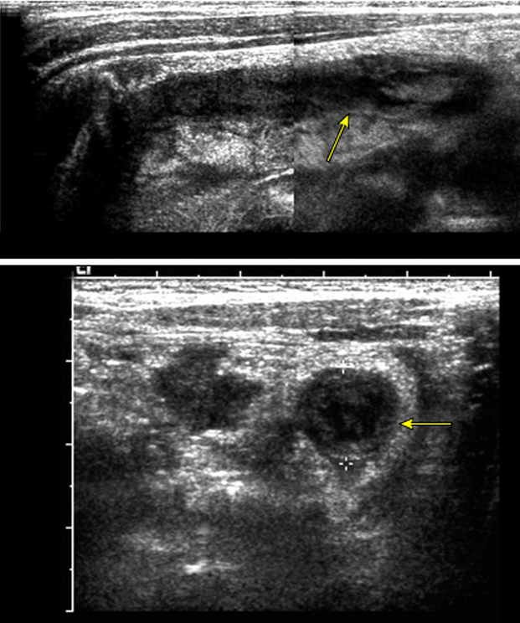
Ultrasound
Acute appendicitis =noncompressible, tenderness, hyperemic & thickened (>6-7 mm)(>2mm wall thickness), Mesenteric Thickening
Notes:
Acad Emerg Med. 2013 Jul;20(7):697-702.

Slide 30
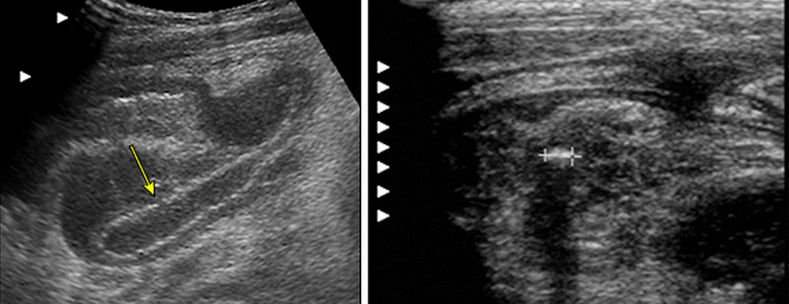
Ultrasound
Signs of Perforation
Notes:
Acad Emerg Med. 2013 Jul;20(7):697-702.

Slide 31
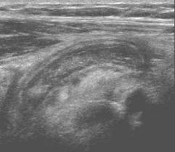
Ultrasound
Sensitivity 98% (If the appendix is seen)
Specificity was 93% in children
Appendicitis
US
2%
98%
93%
7%
Normal Appendix
Notes:
Acad Emerg Med. 2013 Jul;20(7):697-702.

Slide 32
Ultrasound
Acute appendicitis =noncompressible, hyperemic & thickened (>6-7 mm)
Meta analyses sensitivity 83%
specificity was 93% in children
Appendicitis
US
17%
83%
93%
7%
Normal Appendix

Slide 33
Ultrasound- “Grey Zone”
US
Appendicitis
?%
?%
?%
?%
Normal Appendix
Notes:
Success at Yale is 84%
THIS IS ATYPICAL in community… more like 50% equivocal…

Slide 34
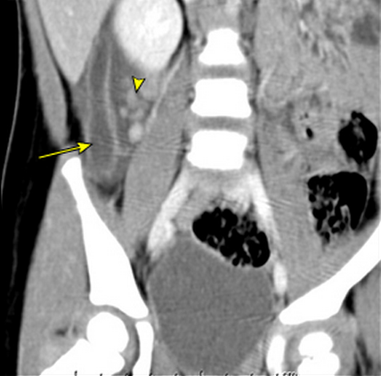
CT
Appendicitis=Thickened wall(>2mm), Surrounding Inflammation

Slide 35
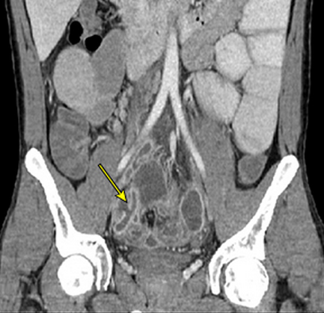
CT
Perforation Can be Identified

Slide 36
CT
Sensitivity of 94-100%, Specificity of 93-100%
IV Contrast Only.
Try to Limit Radiation (lower tube current/table speed)
Appendicitis
CT
6%
94%
93%
7%
Normal Appendix
Notes:
Garcia et al reviewed the CT scans on 156 consecutive patients with normal abdominal CT scans during the evaluation of appendicitis. Two of 156 patients found ultimately to have appendicitis for a false negative rate of 1.3%

Slide 37
Does the Use of CT help
Perforation rates (33%) are the same as 1990’s despite increased use of CT
<5 years old Negative Appendectomy Rate
Without CT scan ~15%
With CT scan 1.2%
Notes:
Garcia et al reviewed the CT scans on 156 consecutive patients with normal abdominal CT scans during the evaluation of appendicitis. Two of 156 patients found ultimately to have appendicitis for a false negative rate of 1.3%
Diagnostic imaging and negative appendectomy rates in children: effects of age and gender.
AU
Bachur RG, Hennelly K, Callahan MJ, Chen C, Monuteaux MC
SO
Pediatrics. 2012;129(5):877.

Slide 38
Atypical Cases
Score < 4 Discharge
Score 5-7 Consider imaging
Score > 8 Operation
Previously healthy 15 year old girl with
Peri-umbilical pain followed by emesis
Now she is hungry.
Pain migrated to the RLQ
Tm 99.9 Tender to deep palpation RLQ.
WBC 13 (ANC 8000) HCG Negative
Tally
1
1
2
4
6
US at 12h of symptoms non-visualized appendix
Notes:
A previously healthy 15 year old girl with periumbilical pain followed by emesis and persistent nausea.
The pain migrated to the right lower quadrant where she has pain.
Tm 101.3 Tender to percussion RLQ. WBC count 13 (ANC 8000)

Slide 39
What if the H&P and Imaging are Unclear?
Onset
Peri-umbilical Pain
Anorexia/Emesis
Migration of Pain to RLQ
RLQ Tenderness
Fever/Worsening Pain
Perforation
Observe
24 hours
Diagnostic Lap?
Repeat US?
CT v MRI?
48 hours

Slide 40

Scan? Observe? TRANSFER?
Notes:
Scan time 19 minutes

Slide 41
Summary
Appendicitis is a common diagnosis in children & perforation is common in young patients.
It is and will be a source of diagnostic confusion for the pediatrician, ER physician and surgeon managing these patients.
Diagnostic imaging has reduced the false negative appendectomy rate at the cost of radiation exposure.
Despite laboratory tests and imaging, clinical understanding of the time-course and presentation of appendicitis is vital to optimal treatment.

Slide 42
Thank You

Slide 43
Illustrative Cases from the Community Hospital
Cases meant to be interactive and engage all participants, please chime in!

Slide 44
Case 1 – Dr. Woll → Dr. Stitelman
9y M w/ 2hrs of abdominal pain
Woke from sleep
Also w/ fever to 101 and nbnb vomiting
Multiple sick contacts with gastro at school
HD stable
Soft belly w/ TTP in RLQ and +Rovsing sign
DDx – Likely AGE, Consider Appy
  less -Colitis, Strep, SBO, testicular torsion, UTI, DKA
Plan – Line, Labs, Hydration, Pain control, US

Slide 45
Case 1 – Woll → Stitelman
WBC 22, 85% PMN
US 9mm appendix, hyperemic, non-compressible, wall thickening, positive appendicolith
Gen Surg at Comm Hospita requests Pedi Surg evals
Yale Pedi Surg via Y-Access, accepts via PED
To OR, uncomplicated Lap Appy
Home same day!

Slide 46
Discussion Points
NOT a diagnostic mystery here…
Absolute versus Relative indications for transfer?
  Age of patient? Patient’s Comorbidities?
  Duration of symptoms / concern for perforation / anticipated surgical complexities?
  Peds surgery versus Gen surgery at community hospital?
  Peds Anesthesia versus General anesthesia at community hospital?
  Patient / Family preference?
Other thoughts from the community hospital participants?

Slide 47
Case 2 – Goldman → Solomon
Acute onset abdominal pain in healthy 12y M.
Pain woke from sleep. Had normal day at camp and normal dinner.
Pain is diffuse w/ nausea.
No - fevers / emesis / urinary sx’s / testicular pain / traumas / Sore throat / cough
HD Stable
Guards on the right. Won’t jump. Nml GU exam
Early AGE
Early appy?
Doubt UTI / Torsion / strep / pna

Slide 48
Case 2 – Goldman → Solomon
WBC 14 / ANC 73%
US – “No appendix identified. Free fluid is seen in the RLQ which is unusual in young man. In proper clinical setting, appendicitis is not excluded. If clinically indicated, CT ab/pel w/ IV and PO contrast is suggested.”
Plan – Shared decision making with family
  Home vs. Gen Surg c/s (CT) vs. Team-up with Yale Pedi surg
  HD stable, sent via car*
    At Yale, US quite positive for appy, OR uncomplicated
Discussion Points –
  Transfer for a repeat US and Pedi Surg evals or CT at community hosp?
  CT ab / pelvis need PO contrast?
    Know what your consultants are going to recommend before calling!
  Safety in the car?

Slide 49
Cases 3, 4, 5! All from Same Community Hospital!
5 yo M w/ low temps, mild ab pains, dec POs, challenging exam...
  WBC 17K, ANC 80%, US equivocal
    Sent to Yale, no abx, Repeat US positive, to OR
  WBC up ANC up, US equivocal, CT at GH equivocal!!!
    Sent to yale, no abx, reviewed all data and exam, cleared for dc home
  WBC up, ANC up, US equivocal
    Sent to Yale at that time, no ABX, Repeat US equivocal, admit for obs, dchome next day
      No OR, no CT.
      Yes hospitalization, ambulance, time, cost
Discussion Points:
Pedi Surg team… When in the workup do you want to get involved?
  Other important DDx in this age group?
  Are any of the above mini cases “wrong” in your mind?
Community team – Your thoughts?

Slide 50
Open Discussion
Other Cases or Questions from the community hospital team?
Next time, you guys will present the cases!!! ☺

Slide 51
QI Project Anyone?
Do any of you perceive a problem in your shop?
  Too many CT’s?
  Too many transfers and dc from Yale PED?
    False positives
We can help you review your appy cases?
Obtain a baseline of things like CT rate, “Over transfer” rates, etc..
Consider rolling out an Evidence Based Guideline or other interventions to move the needle?

Slide 52
Example Appy Approach EBG (kids >4yo)
Step 1 = Risk Stratify – IV, CBC, HCG, UA, NS, PAS
PAS >/= to 4?
Risk Stratify Again = PAS + WBC/ANC + US
PAS = 10 Points
Migration of Pain = 1
Anorexia = 1
N/V = 1
RLQ Tenderness = 2
Cough/Hop Pain = 2
Fever = 1
WBC >/= 9K = 1
PMN >/= 65% = 1
< 4 = STOP, look for other stuff
>/=4 = Get that US while waiting on WBC/ANC, hydrating and treating pain.
If no US, transfer for US
WBC < 9 / ANC <65%
  US NEG = Safe DC
  US POS or EQUIVOCAL = MOD RISK
    Transfer, MR or CT or Admit for exams
WBC >/= 9 / ANC > 65%
  US POS = HIGH RISK → Surg c/s
  US NEG or EQUIVOCAL = MOD RISK
    Transfer, MR or CT or Admit for exams
Bachur et al, 2016
Notes:
Note, PAS has WBC in it from the get go!

Slide 53
ECHO #1 Conclusion Slide
Thanks!
Next one up = Bronchiolitis / Impending Respiratory Failure
Be in touch if you want to do some QI work together

