Slide 1
Sexual Assault Evaluation
Dr. Lisa Pavlovic
Medical Director YCAC

Slide 2
History
Prepubertal
Minimal Facts – Who/When/What
Adolescent
Minimal facts – Forensic interview

Slide 3
Forensic Evidence Collection
Prepubertal
24 hours
Physical evidence of injury or STI
Blue Maxx
CLOTHING
Adolescent
Within 72 (up to 120)
CLOTHING
Age of consent for kit is 13

Slide 4
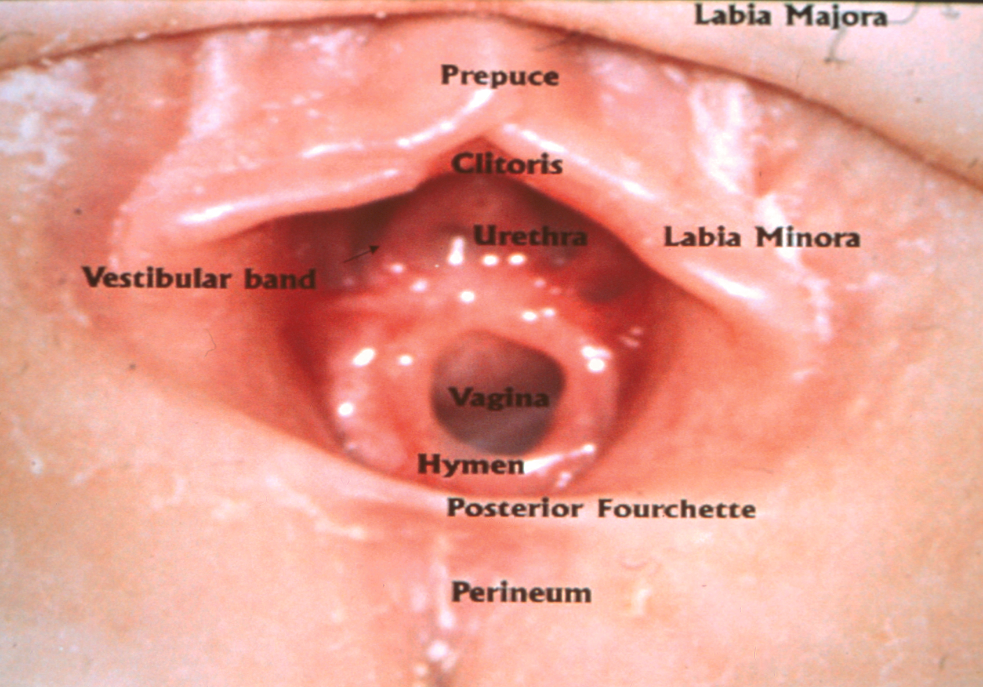

Slide 5
12
9
3
6
Notes:
Hymen in Supine Frog-Leg Position,
Review anatomy and unestrogenized state of the tissue

Slide 6
12
9
3
6
Notes:
Hymen in Supine Frog-Leg Position,
Review anatomy and unestrogenized state of the tissue

Slide 7
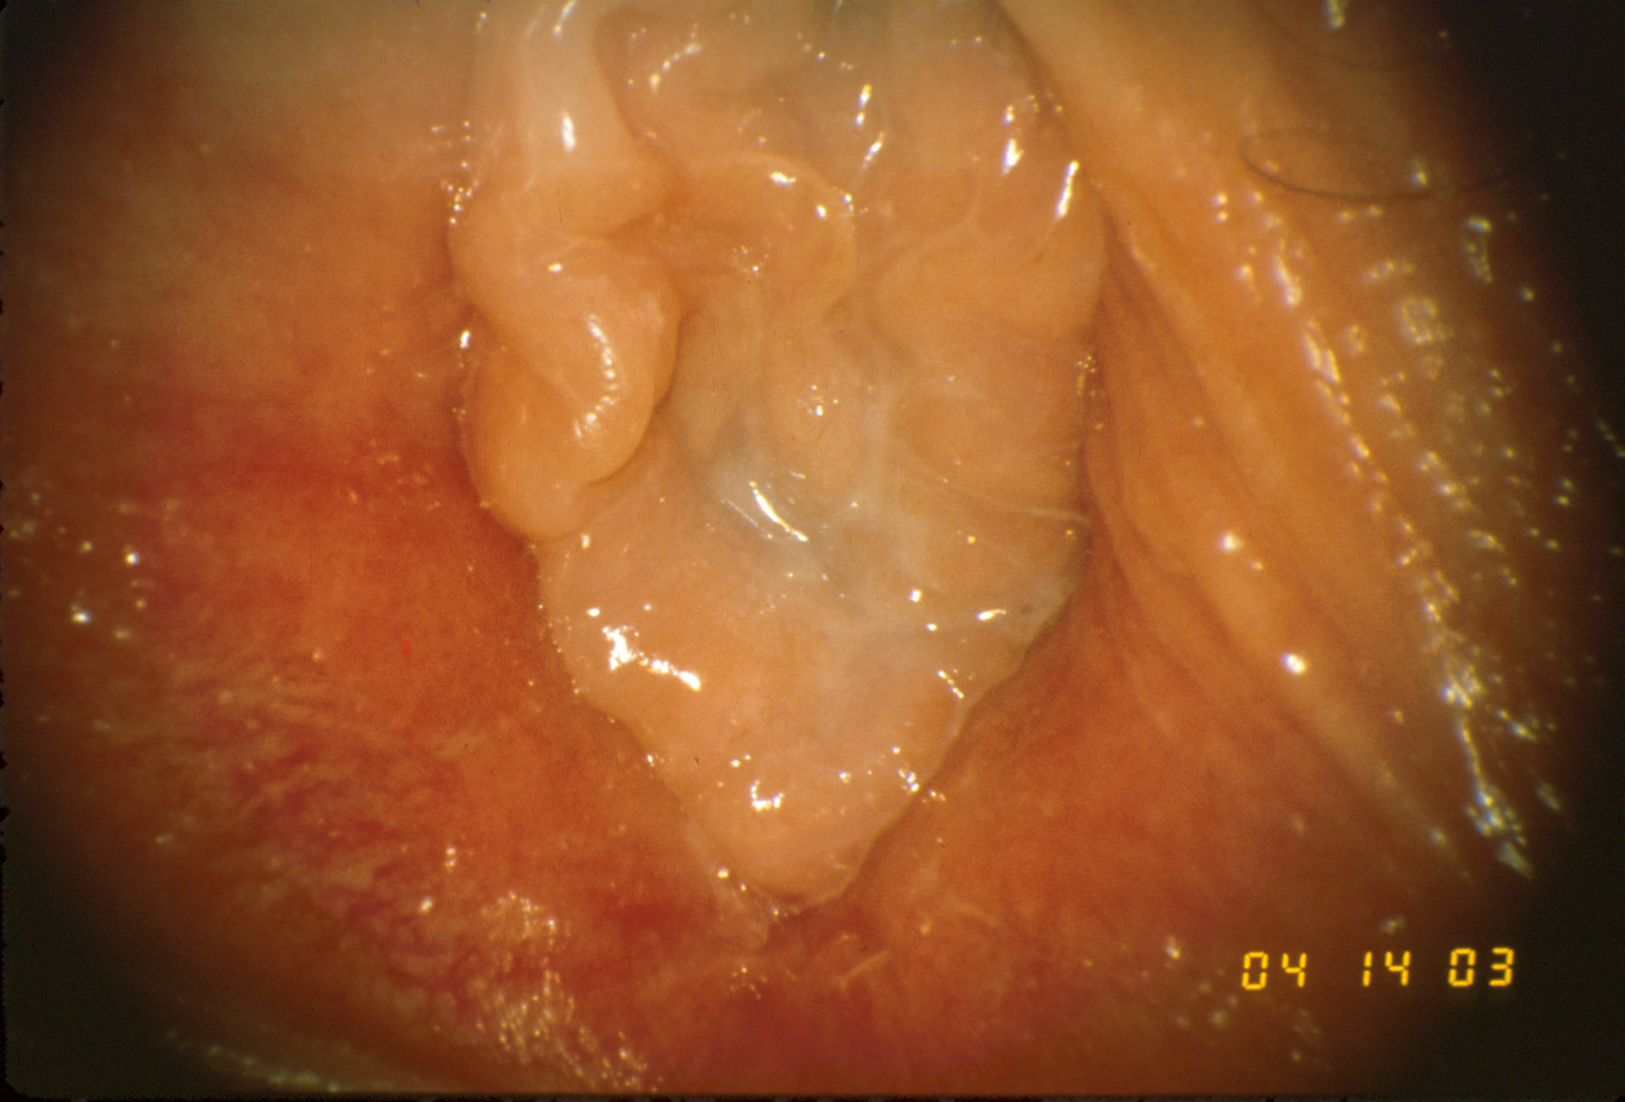

Slide 8
Notes:
Estrogenized

Slide 9
Notes:
Complete hymenal transection and posterior bruising

Slide 10
Connecticut Laws
Age of Consent is 16
Statuatory Rape if less than 16 and greater than 3 year age difference
Age of consent 18 if offender is over 20 and in a coach/instructor role

Slide 11
When to Transfer
Uncomfortable
Pediatric Gynecology
Admission

Slide 12
Yale Child Abuse Clinic
All cases of child sexual abuse
Forensic interview
Colposcope exam
STI testing
Mental health referral

