Slide 1

Adolescent Health & Confidentiality:
Teen Legal Rights & Healthcare Access in the Emergency Department
Jay Sicklick, Esq.
Center for Children’s Advocacy
August 6, 2018
cca-ct.org

Slide 2
Goals of this Presentation
Discuss the basic legal principles of teen legal rights & confidential treatment in the Emergency Department setting
Discuss the practical complications of adhering to teen confidentiality in the ED setting.
Provide some background on the unique nature of adolescent confidentiality and the relationship to child welfare reporting (as mandated reporters)
Describe how confidentiality works in the brave new world of EHR
mlpp
cca-ct.org

Slide 3

5 Take Home Points
Minors Under 18 CANNOT generally make routine healthcare decisions for the themselves!
Minors may make critical healthcare decisions and consent to treatment in FOUR protected areas: those areas are: Reproductive Health, Mental Health Treatment, Substance Abuse Treatment & HIV/AIDS
Parents DO NOT have the right to view confidential healthcare treatment records in the healthcare (or school health setting) absent their child’s consent (Common law, Statutory & HIPAA).
Children in DCF care (committed to DCF) are treated no differently than those with no DCF involvement.
Once you cross the Connecticut border:
mlpp
cca-ct.org

Slide 4
Overview – Treating the Adolescent
Adolescent’s Legal Rights
Mandatory Reporting Requirement
Provider’s Ethical Obligation
Healthcare Provider Policy
mlpp
cca-ct.org

Slide 5
Principles of Confidentiality
- Definitions -
Who is a minor?
Anyone under the age of 18, except as otherwise indicated
mlpp
cca-ct.org

Slide 6
Informed Consent
Agreement or permission accompanied by full notice about the care, treatment, or service that is the subject of the consent. A patient must be apprised of the nature, risks, and alternatives of a medical procedure or treatment before the physician or other health care professional begins any such course. After receiving this information, the patient then either consents to or refuses such a procedure or treatment.
  General Rule: Minors are not legally capable of providing informed consent for medical/healthcare treatment
mlpp
cca-ct.org

Slide 7
Mature Minor
A minor who exhibits the “maturity” of an adult and is therefore permitted to make decisions, traditionally reserved for those who have attained the age of majority, regarding her own medical care.
Who is a mature minor?
Connecticut courts have not recognized the mature minor doctrine in any reported case
mlpp
cca-ct.org

Slide 8
Emancipation
Emancipation:
  The legal process available by which a 16 or 17 year old minor achieves adult status.
  Statutory but common law examples while rare have been reported.
mlpp
cca-ct.org

Slide 9

Children in DCF Care
No difference in a minor’s right to confidential treatment AND right to consent for child committed to DCF vs. non-DCF involved child. NONE!
mlpp
cca-ct.org

Slide 10

Types of Medical Conditions/Treatments
Reproductive Healthcare
Drug and Alcohol Treatment
Mental Health Treatment – Outpatient and Inpatient
Testing and Treatment of HIV and AIDS
mlpp
cca-ct.org

Slide 11

Reproductive Health Care:
Treating the Adolescent Confidentially!
Birth Control
Pregnancy
Counseling
Abortion
Sexually Transmitted Diseases
mlpp

Slide 12

Contraception
mlpp
cca-ct.org

Slide 13
Contraception (cont.)
Query: What if a 12 year old minor seeks to obtain contraception?
  Would the 12 year old be entitled to obtain the contraception?
  Is there a reporting requirement for this event?
  What do you need to know, if anything, to proceed ahead with a report to the hotline on this activity?
mlpp
cca-ct.org

Slide 14

Pregnancy
mlpp
cca-ct.org

Slide 15

Abortion and Termination of Pregnancy
mlpp
cca-ct.org

Slide 16

“Morning After” Pill
Protected under auspices of “birth control”
Mandated for all hospitals in case of rape or incest
FDA permits minors to obtain w/out prescription
mlpp
cca-ct.org

Slide 17

Sexually Transmitted Diseases
mlpp
cca-ct.org

Slide 18

HIV & AIDS
mlpp
cca-ct.org

Slide 19

Mental Health Treatment: Outpatient
cca-ct.org

Slide 20
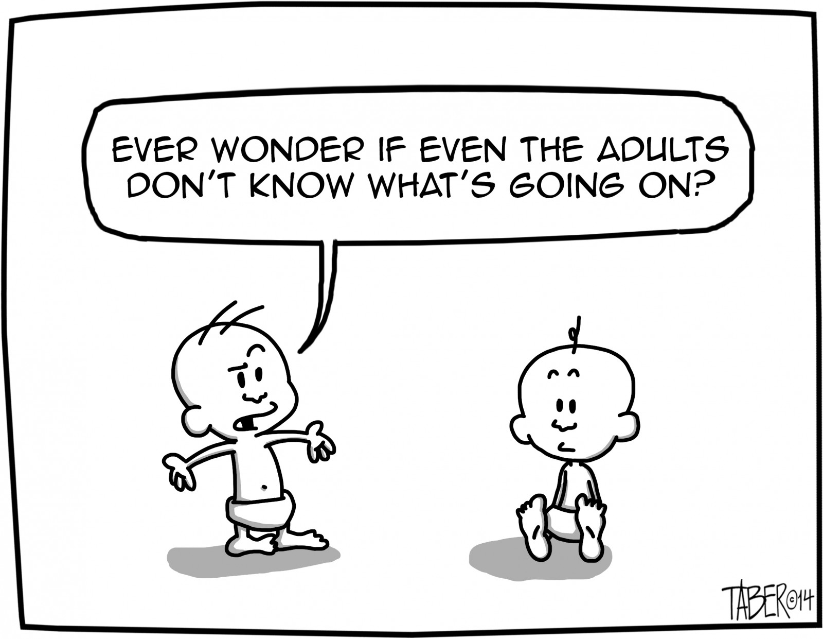
Questions?
mlpp
cca-ct.org

Slide 21

Resources
Center for Children’s Advocacy: www.cca-ct.org (860) 570-5327
DCF Web Site: www.state.ct.us/dcf
DCF Care Line: (800) 842-2288
Fed Govt. - Administration for Children & Families: www.acf.hhs.gov
MLPP: www.ccmckids.org/mlpp (860) 570-5327
CCMC – SCAN Program (860) 545-9995
Yale Child Study Center (203) 785-2513
mlpp
cca-ct.org

Slide 22
Resources (cont.)
mlpp
cca-ct.org
DSS Web Site: www.state.ct.us/dcf
www.ct.gov/dss
End Hunger CT (860) 560-2100
Planned Parenthood of CT Web Site: www.ppct.org
Conn. AIDS Resource Coalition: www.ctaidscoalition.org/fairfield.htm

Slide 23
Questions?
Jay Sicklick, Esq.
jsicklick@cca-ct.org
860-570-5327 ext 257
cca-ct.org

