Slide 1
When to worry about abuse in young children with fractures
John M. Leventhal, MD
Professor of Pediatrics

Slide 2


Slide 3
Fractures in young children
1. When to worry about abuse
2. What data can be helpful
3. Are there fractures highly specific for abuse?

Slide 4
A question for you
What 3 characteristics do you rely on when considering abusive vs accidental fractures?

Slide 5
5 cases
Describe the fracture (to yourself)
Would you report the case to DCF based on the very brief history and the image?

Slide 6
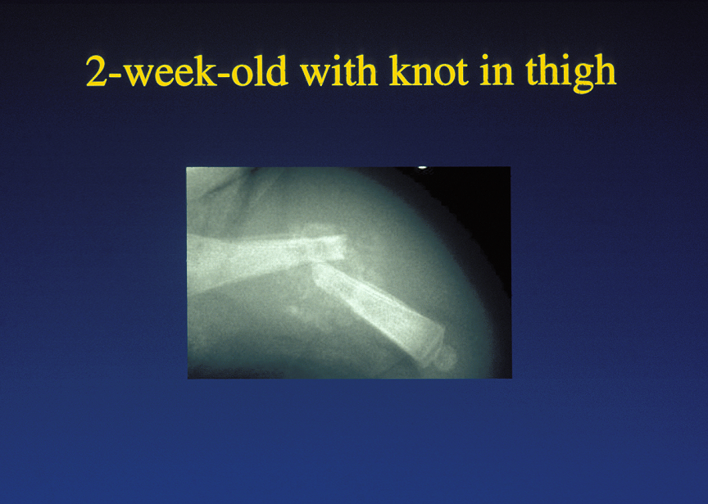

Slide 7
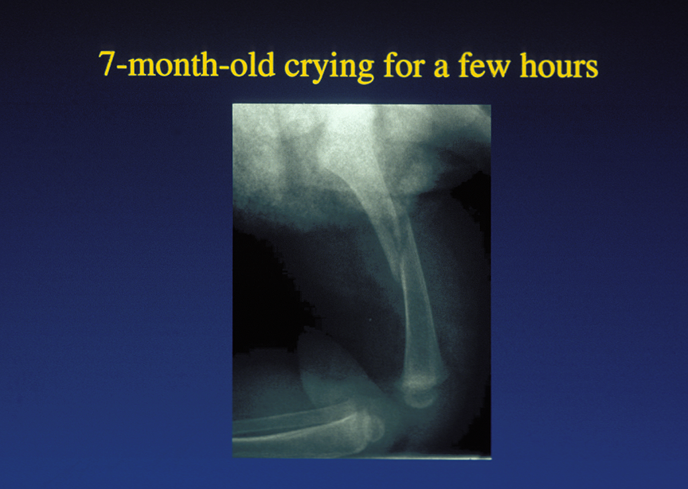

Slide 8
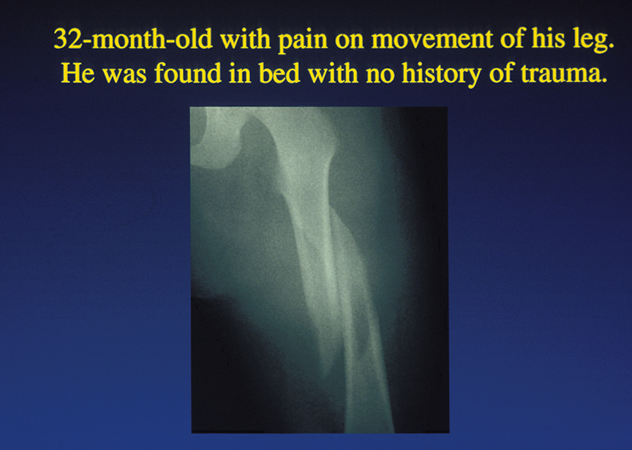

Slide 9
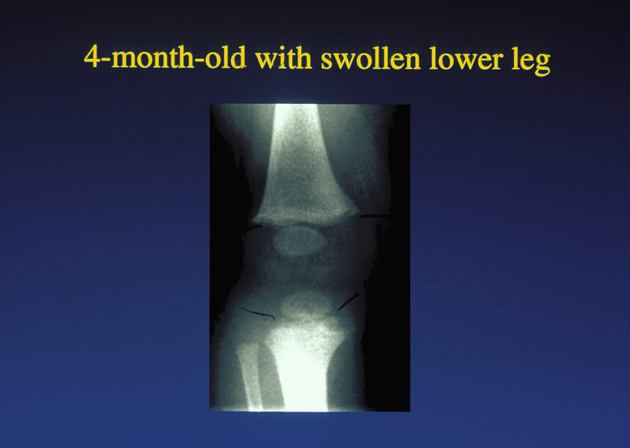

Slide 10
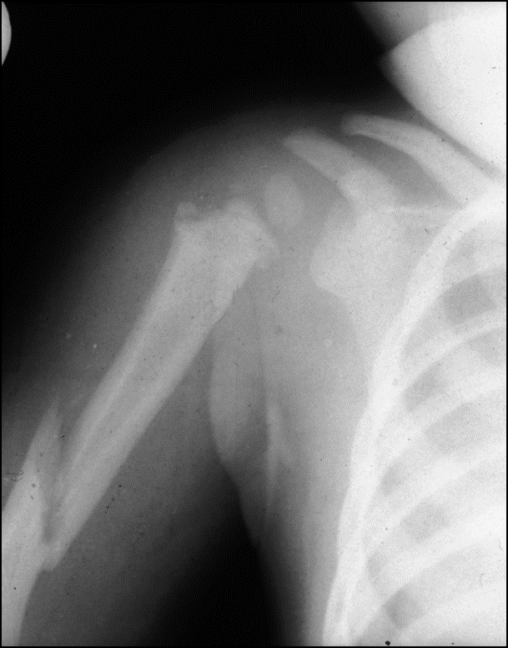
10 month-old picked up out of playpen by dad

Slide 15
10 month-old picked up out of playpen by dad

Slide 16
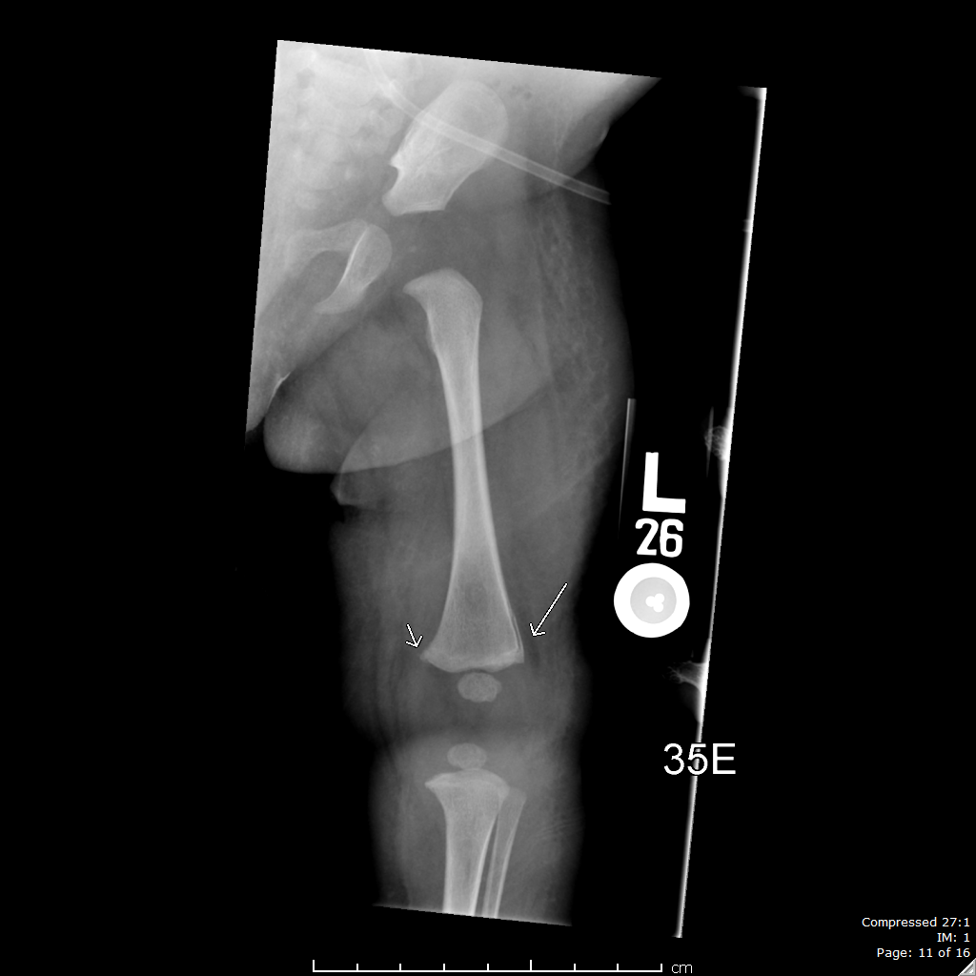
CML (corner or bucket handle)

Slide 17
Differential diagnosis of fractures in young children
Accident
Abuse
Birth
Increased bone fragility:
  Rickets
  Extreme prematurity
  O. I. (Osteogenesis imperfecta)
  Phosphate wasting due to Neocate
  Marked disuse

Slide 18
Data collection
Detailed history:
  What actually happened?
  Who was present at the time of the event?
  Who saw/heard what?
  Who decided to bring child for medical care?
  (Was the boyfriend alone with the child?)
PMH: birth, underlying medical problem
Careful exam looking for other bruises/injuries
Labs: Ca, Phos, Alk phos, 25 hydroxy vit D, PTH
Imaging: CT of head if < 6 months of age
Consider transfer or admission
Skeletal survey

Slide 19
Skeletal survey in children with a fracture
Order in children < 24 months of age if fracture is suspicious for abuse
  All children < 6 months of age
  Most children 6 months to 11 months of age
  Some children > 12 months of age
Includes 19 x-rays (including left and right oblique chest)
Yield is 10 to 20%
Siblings < 24 months of age
  Especially twin infant
  Yield 10%
Follow-up skeletal survey in 2 weeks can show additional fractures
At Yale, read independently by 2 pediatric radiologists

Slide 20
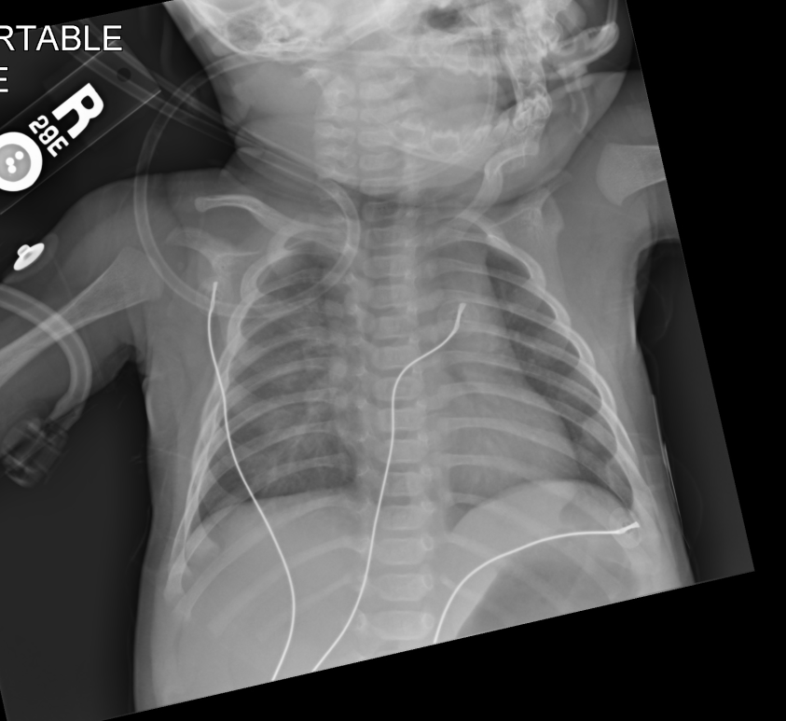
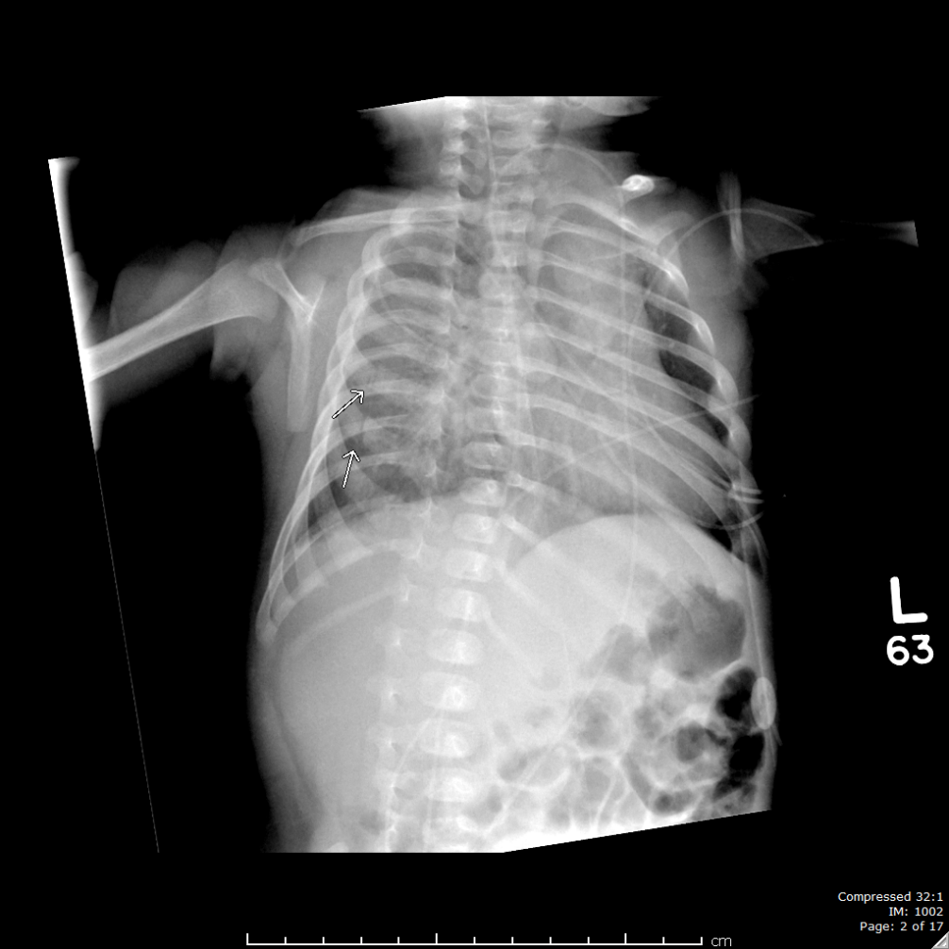
10-week-old with acute rib fractures

Slide 21
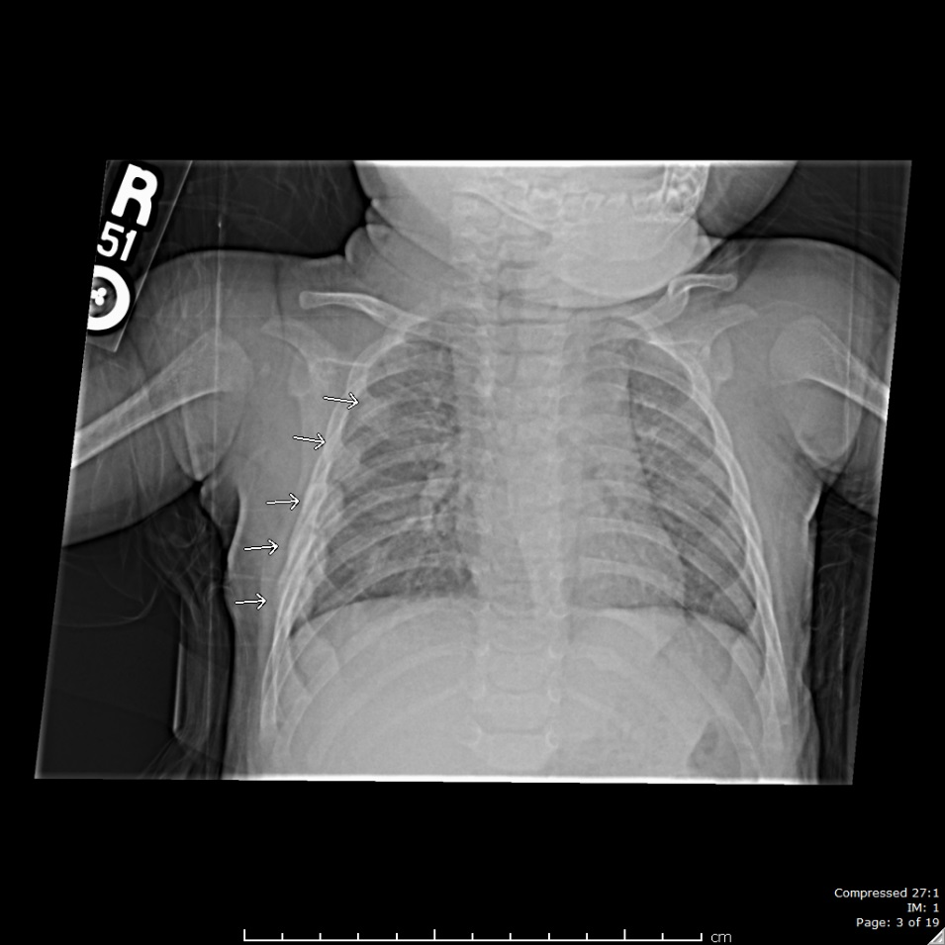
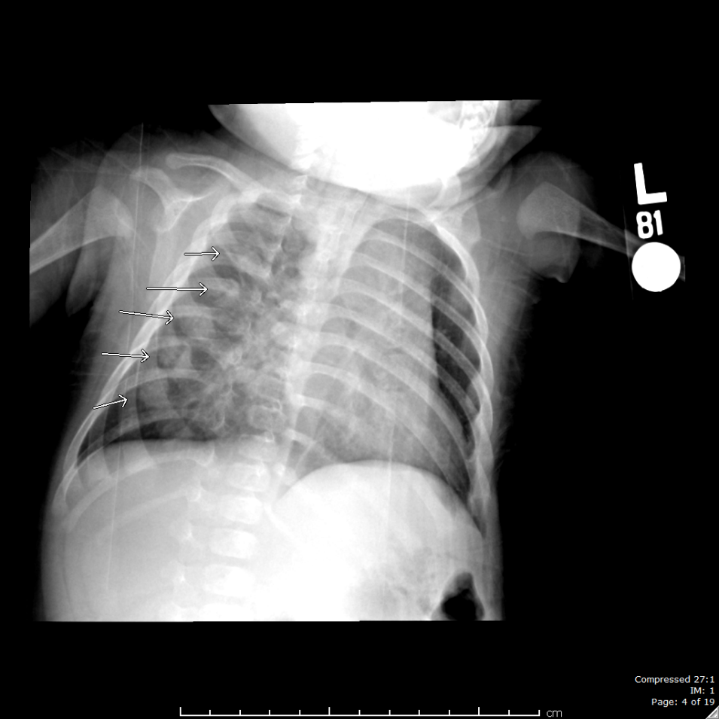
Follow-up skeletal survey

Slide 22
Decision-making
Link history with findings:
  Mechanism
  Severity
  Timing
In a study of 215 children with fractures < 36 months of age, two key histories were noted in abuse cases:
  Abnormality noted (e.g., swelling, pain), but no history of trauma
  History of minor trauma

Slide 23
National data on hospitalized children with fractures
Likelihood of abuse in hospitalized children with fractures:
  < 12 months -- 23%
  12 to 23 months -- 9%
  24 to 35 months -- 4%
Likelihood of abuse in infants based on location of fracture:
  71% scapula
  65% rib
  60% tibia/fibula
  57% radius/ulna
  43% humerus
  36% clavicle
  32% femur
  15% skull (most common occurring fracture in this age )

Slide 25
Types of accidents (think developmentally)
Dropping the infant when in bed, walking, walking down stairs
Dropping the car seat or falls from car seat, baby carrier
Falls from bed, changing table, couch
Falls when walking, running, twisting, jumping, climbing
Jumping from …

Slide 26
Types of fractures
Transverse: requires high energy
Spiral/oblique: common
Buckle or torus: requires less energy
Supracondylar of humerus
Toddler: tibia (and femur)
CML: Classic Metaphyseal Lesion – highly specific for abuse in infants

Slide 27
Summary
Get a detailed history
When evaluating, think age and developmental skills
¼ of infants hospitalized with fractures are due to abuse
Skeletal survey can be very helpful
Do not forget siblings, especially twin infants
Call DART for advice:
  203-688-2468

