Slide 1
Neonatal Delivery Emergencies
Christie J. Bruno, DO
Associate Professor of Pediatrics
Yale School of Medicine
Echo Series 1/9/20

Slide 2
Conflicts of Interest
I have nothing to disclose

Slide 3
Learning Objectives
By the end of this session, learners will be able to:
Demonstrate the initial steps of newborn resuscitation
Describe specific considerations for premature newborns
Describe how neonatal resuscitation differs from resuscitation for other patient populations

Slide 4
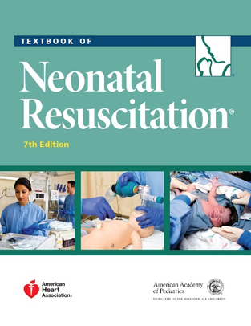
Neonatal Resuscitation Program(NRP)
American Academy of Pediatrics
-Simulation is an integral part of provider and instructor courses
-Cognitive assessment with
test completion
-E-sims
-Skills stations
-Integrated skills stations
-Interdisciplinary mock codes

Slide 5
Current NRP Recommendation
Every birth should be attended by a provider trained in NRP(Course renewal very 2 years)
4 million annual births in US
10% neonates require resuscitation
1% neonates-extensive resuscitation
Pediatric provider called for “higher risk” deliveries

Slide 7
Airway
Place head in “sniffing” position
Suction mouth, then nose.
Breathing
If apneic, gasping, or HR<100bpm, give PPV at 40-60 breaths/min
Listen for rising heart rate for first 15 seconds of PPV
If HR not rising and chest not moving with PPV, do MR SOPA until chest moves with PPV for 30 seconds.
Attach pulse oximeter, consider cardiac monitor.
Intubate or place laryngeal mask and give PPV for 30 seconds prior to starting compressions.
Use CO2 detector after intubation or insertion of laryngeal mask
Circulation
Start compressions if HR is <60 bpm after 30 seconds of PPV with chest movement. Check HR every 60 seconds.
Cardiac monitor is preferred method for assessing HR during CPR.
Give 3 compressions: 1 breath every 2 seconds. Use 100% oxygen.
Compress one-third of the anterior-posterior diameter of the chest.
Drugs
Give epinephrine if HR if <60 bpm after 60 seconds of CPR
Caution: epinephrine dosage is different for ET and IV routes.

Slide 8
Importance of Planning and Set up
Role clarification in team lead and delegation of tasks
Make sure important equipment is present and that it is set up
Introduce yourself to resuscitation team and speak with family if time allows

Slide 9
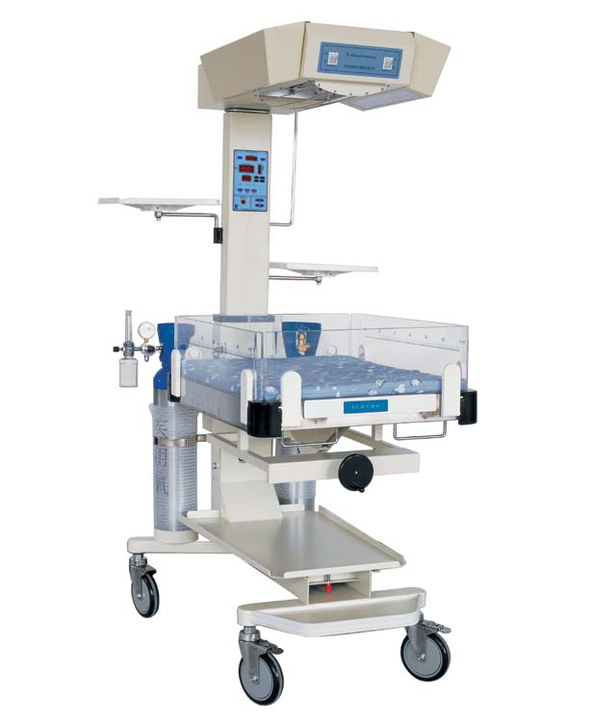
Equipment Set Up
Warming
Preheated warmer
DR/OR room temp 74-77⁰ F
Warm towels or blankets
• Temperature sensor and sensor cover
• Hat
• Plastic bag or plastic wrap (<32 weeks’ gestation)
• Thermal mattress (<32 weeks’ gestation)

Slide 10
Equipment Set Up
• Bulb syringe
• 8F suction catheter attached to wall suction, set at 80 to 100 mmHg (have 10F or 12F available)
• Stethoscope
• Flowmeter set to 10 L/min
• Oxygen blender set to 21% (21%-30% if <35 weeks’ gestation)
• Positive-pressure ventilation (PPV) device and/or T-piece resuscitator preferred
• Term- and preterm-sized masks

Slide 11
Devices for Positive Pressure Administration

Slide 12
Equipment Set Up
• Pulse oximeter with sensor and cover
• Target oxygen saturation table
• Laryngoscope with size - 00, 0 straight blades (size 1, optional)
• Stylet (optional)
• Endotracheal tubes (sizes 2.5, 3.0, 3.5)
• Carbon dioxide (CO2) detector
• Measuring tape and/or endotracheal tube insertion depth table • Tube-securing tape and/or device
• Scissors
• Laryngeal mask (size 1) and 5-mL syringe (have available)

Slide 13
Equipment Set Up
• Supplies for peripheral IV access and administering medications
• Supplies for placing emergency umbilical venous catheter
• Electronic cardiac (ECG) monitor leads and ECG monitor
• 1:10,000 (0.1 mg/mL) epinephrine
• Normal saline

Slide 14
Maintain Normothermia
Goal temperature 36.5-37.5 C
Increase room temperature to 74-77 F
• Place a hat on newborn
• For newborn < 32 weeks gestation, use a thermal mattress and/or plastic wrap
• Consider using temperature probe

Slide 15
Maintain Normothermia
Hypothermia and hyperthermia are associated with adverse outcomes
Hypothermia is associated with respiratory distress, hypoglycemia, infection, intraventricular hemorrhage
Hypothermia is associated with increased neonatal mortality

Slide 16
Newborn Resuscitation Initial Steps
• Provide warmth to newborn
• Head and neck in neutral “sniffing position”
• Suction if concern for obstruction
• Dry > 32 week infant and plastic wrap <32 week infant
• Stimulate infant
• Perform assessment of breathing
• Apneic or gasping → Start positive pressure ventilation

Slide 17
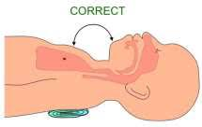
Appropriate Sniffing Neutral Position

Slide 18
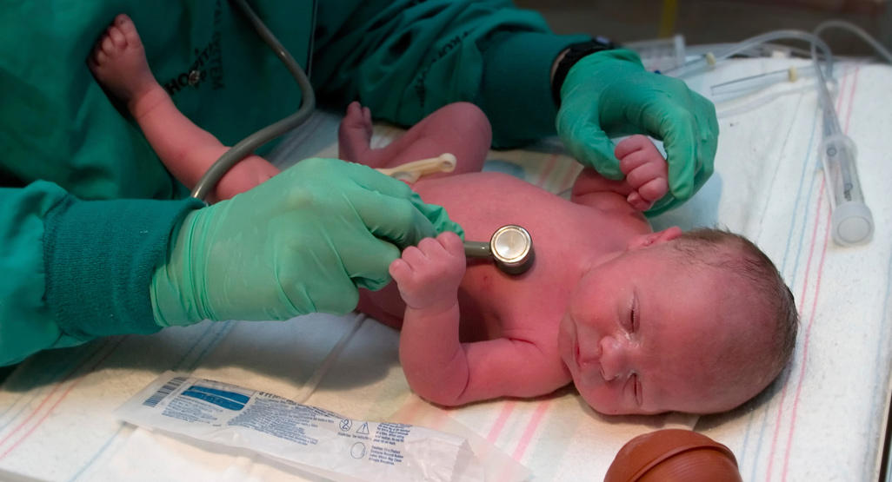
Heart Rate Assessment via Auscultation
Traditional umbilical cord method is not reliable
Auscultation with stethoscope is preferred but with limited reliability
If unclear heart rate and infant is depressed, apply pulse oximeter and/or ECG leads, connect to monitor

Slide 19
Recommended Oxygen Administration
Liter flow is 10 LPM
Initial FiO2=21% for >35 weeks and 30% for <35 weeks gestation
Pulse oximeter should be placed on right upper extremity with oxygen administration to guide use
100 % FiO2 should be used when chest compressions are administered

Slide 20
Postnatal Oxygen Target Ranges

Slide 21
Effective Ventilation for 30 seconds

Slide 22
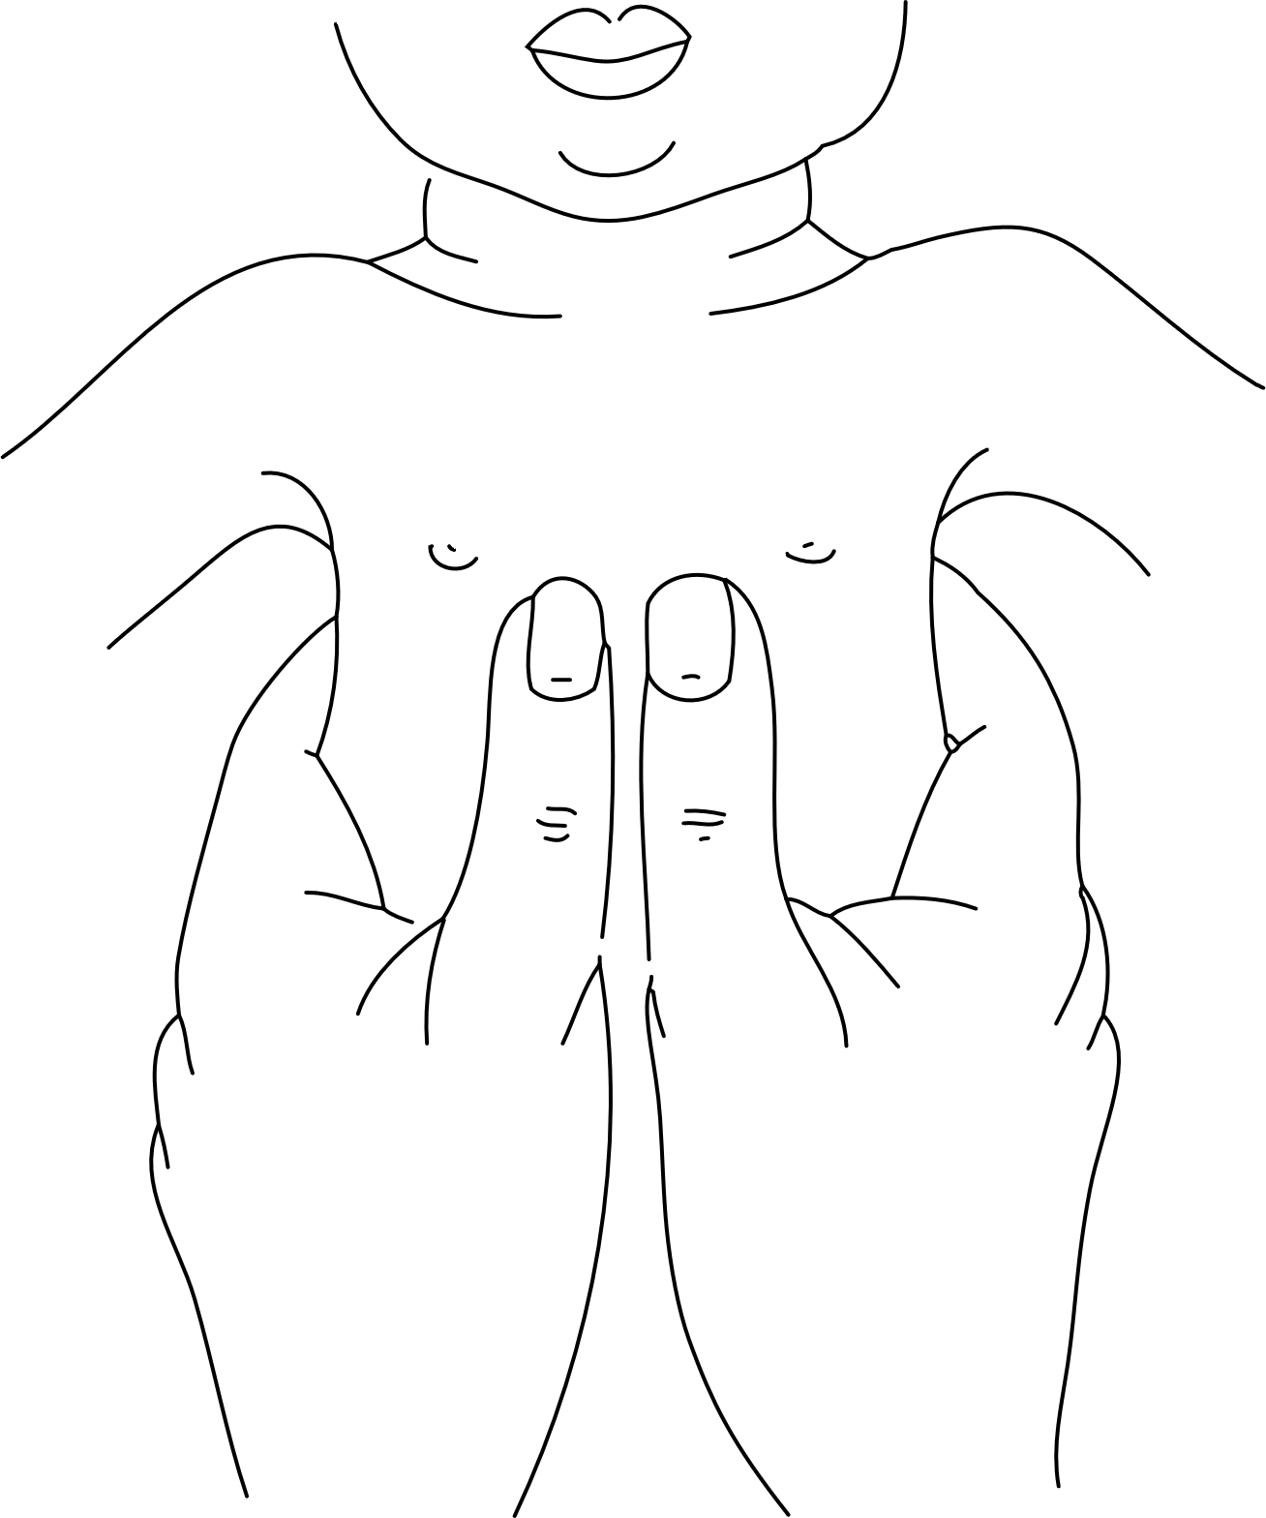
Chest Compressions
Indicated if heart less than 60 beats per minute in spite of EFFECTIVE ventilation
• Two thumb technique is recommended
• Three to One compressions to breaths ratio
• Continue for 60 seconds prior to checking HR

Slide 23
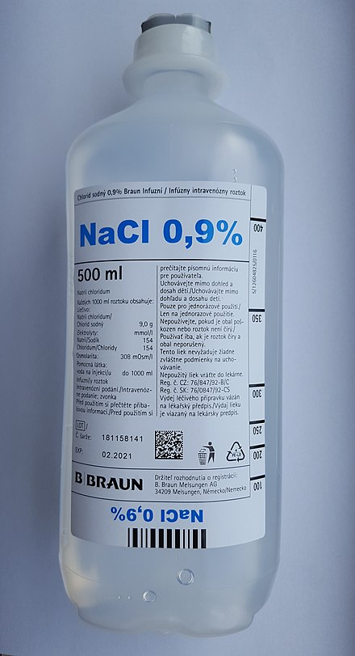
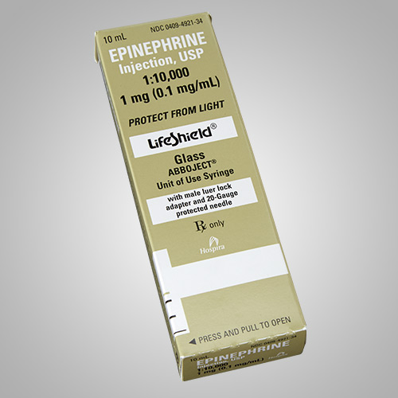
Medications
Epinephrine(1:10,000) IV or IO preferred
Endotracheal Epinephrine does not count
Normal saline or O negative blood- 10mL/kg bolus

Slide 24
Importance of Ventilation in NRP
Ventilation is key to a successful neonatal resuscitation
Preparation and teamwork improves success for resuscitation
Textbook of Neonatal Resuscitation, 7th Edition, American Academy of Pediatrics

