Slide 1
Intimate Partner Violence & COVID-19

Slide 2
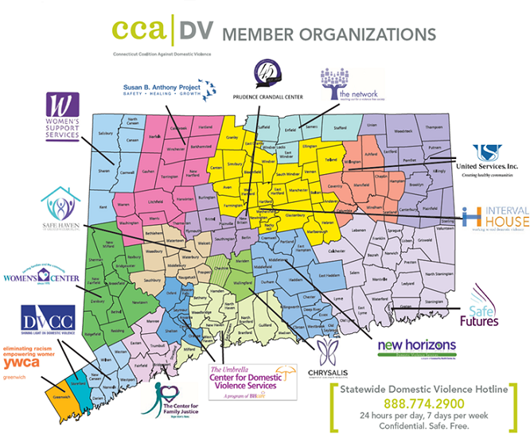
Resources
SERVICES:
Counseling
Support groups
Emergency shelter/ safe house
Court advocacy
Safety Planning
Lethality Assessment
Information & referrals
24/7 Advocates
Education

Slide 3
IPV Statistics
National
Statistics
Connecticut FY19 Numbers
37,773 Victims (33,141 adults/4,632 children)
33,711 Calls were received on the Hotline (available 24/7)
13 Intimate Partner Homicides (average over last 10 years)
2,229 Victims housed in shelter
31,717 Victims received one-on-one counseling
32,927 Victims received court based services
1 in 4 women have experienced severe physical violence by an intimate partner at some point in their life.
1 in 7 men.
Notes:
.

Slide 4
COVID-19 & IPV
Victim/survivors may be experiencing increased isolation, stress and danger caused by social distancing measures.
Victim/survivors who are already more vulnerable to economic & health insecurity are facing additional challenges.
Abusive partners may withhold necessary items, or share misinformation about the pandemic to control or frighten survivors.
CT Law Enforcement is not responding to Medical 911 calls during the pandemic making it more important than ever that EMS and ER staff educate or display IPV resources.
You may be the only person the victim is having contact with, they may not be able to reach out for other services.

Slide 5
Overview

Slide 6
Overview

Slide 8
Comparison of Safe Connect Contacts
First 2 weeks of May vs. the first 2 weeks of April
Total contacts increased by 33% in May.
Non-direct contacts nearly doubled. This was primarily through chat but also included email and texts.
Individuals expressing distress around COVID-19 increased 58% with primary concerns indicating a need for shelter/housing, basic needs, counseling services, financial (loss of employments, utilities etc.) and TRO assistance.
Primary factors reported specific to these concerns included being quarantined with an abusive partner, separation/isolation from support/resources and financial stressors.
LAP calls decreased 23% in May over the same time frame in April. This could be due to change of protocol around COVID and law enforcements response to DV calls and/or victims not calling law enforcement due to concerns around arrest. SC Coordinators have reported victims not wanting to call the police in fear that abuser will be arrested.
There was a 150% increase in callers seeking information/referral for civil legal services (TRO assistance and court information/support)

Slide 9
What to expect: You are in control
People contact Safe Connect for themselves or someone else they care about. Some have questions about their relationships and just want to talk. They take your lead, offering information, options, and positive outcomes.
While many of us have been in situations similar to yours, you are the expert about you.
They will always ask if you are in a safe place to talk or message.
If you are concerned that someone may be monitoring your internet or phone unsafe, please let them know right away, we can help.
They will ask you questions. They do this so we can better understand you and what you’re going through. Share only what you're comfortable sharing.
They like to follow-up with you within 48 hours- but will do this only with your permission, and in the way you tell us feels safest.

Slide 10
Resources
Certified IPV Advocates are available 24/7 through call or text (888-774-2900) or through live chat and email at www.CTSafeConnect.org
Free, confidential, voluntary, and free
CCADV resources at www.ctcadv.org and through our social media
IPV Telehealth Script & COVID-19 response resources available
Virtual trainings and Q&A Sessions available with the Director of Health Professional Outreach & the Director of Training and Prevention at CCADV
As a part of the community safety net, you ARE NOT expected to become experts in IPV.

Slide 11
Ashley Starr Frechette
Director of Health Professional Outreach
Connecticut Coalition Against Domestic Violence
astarrfrechette@ctcadv.org ǀ www.ctcadv.org
Help is available
888.774.2900 24-hour toll-free hotline
www.CTsafeconnect.org
Notes:
CCADV Newsletter
CCADV Facebook Updates
CCADV- Health Professional Outreach Project FWOV links https://drive.google.com/drive/folders/1Y1EPUdvkJaOWqyFrnanNYkWLXj8llgE6

