Slide 1

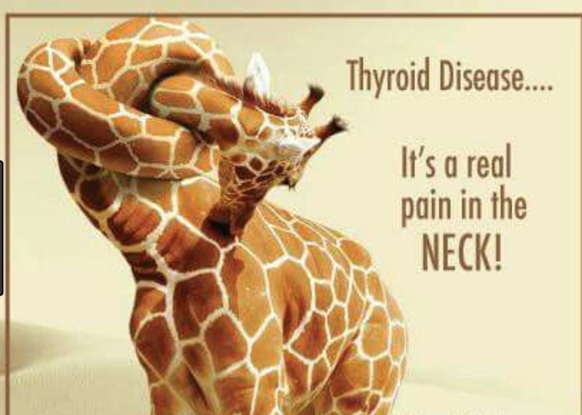
THYROID FUNCTION AND DISORDERS
Stephanie L. Samuels, MD
Catherine Dinauer, MD
Pediatric Endocrinology
8/16/2020

Slide 2
Objectives
Review of thyroid function norms and testing in children
Overview of thyroid test interpretation
Discuss approach to mild thyroid function test (TFT) abnormalities:
  Nonthyroidal Illness
  Subclinical Hypothyroidism
  Subclinical Hyperthyroidism
Cases/Questions
Resource:
American Thyroid Association (ATA) website- patient education section (thyroid.org)

Slide 3
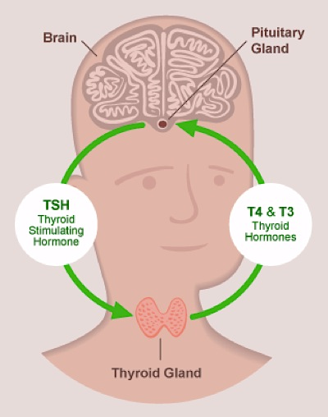
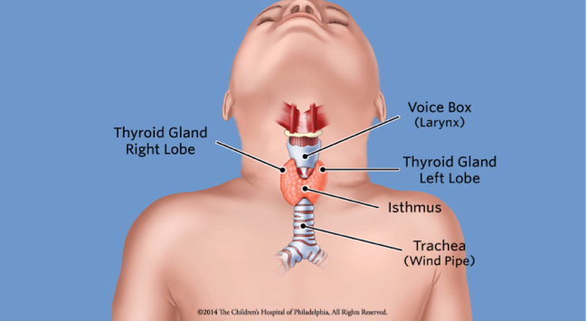
The Thyroid System
Normal thyroid gland function is critical for
Early neurocognitive development
Growth and development throughout childhood

Slide 4
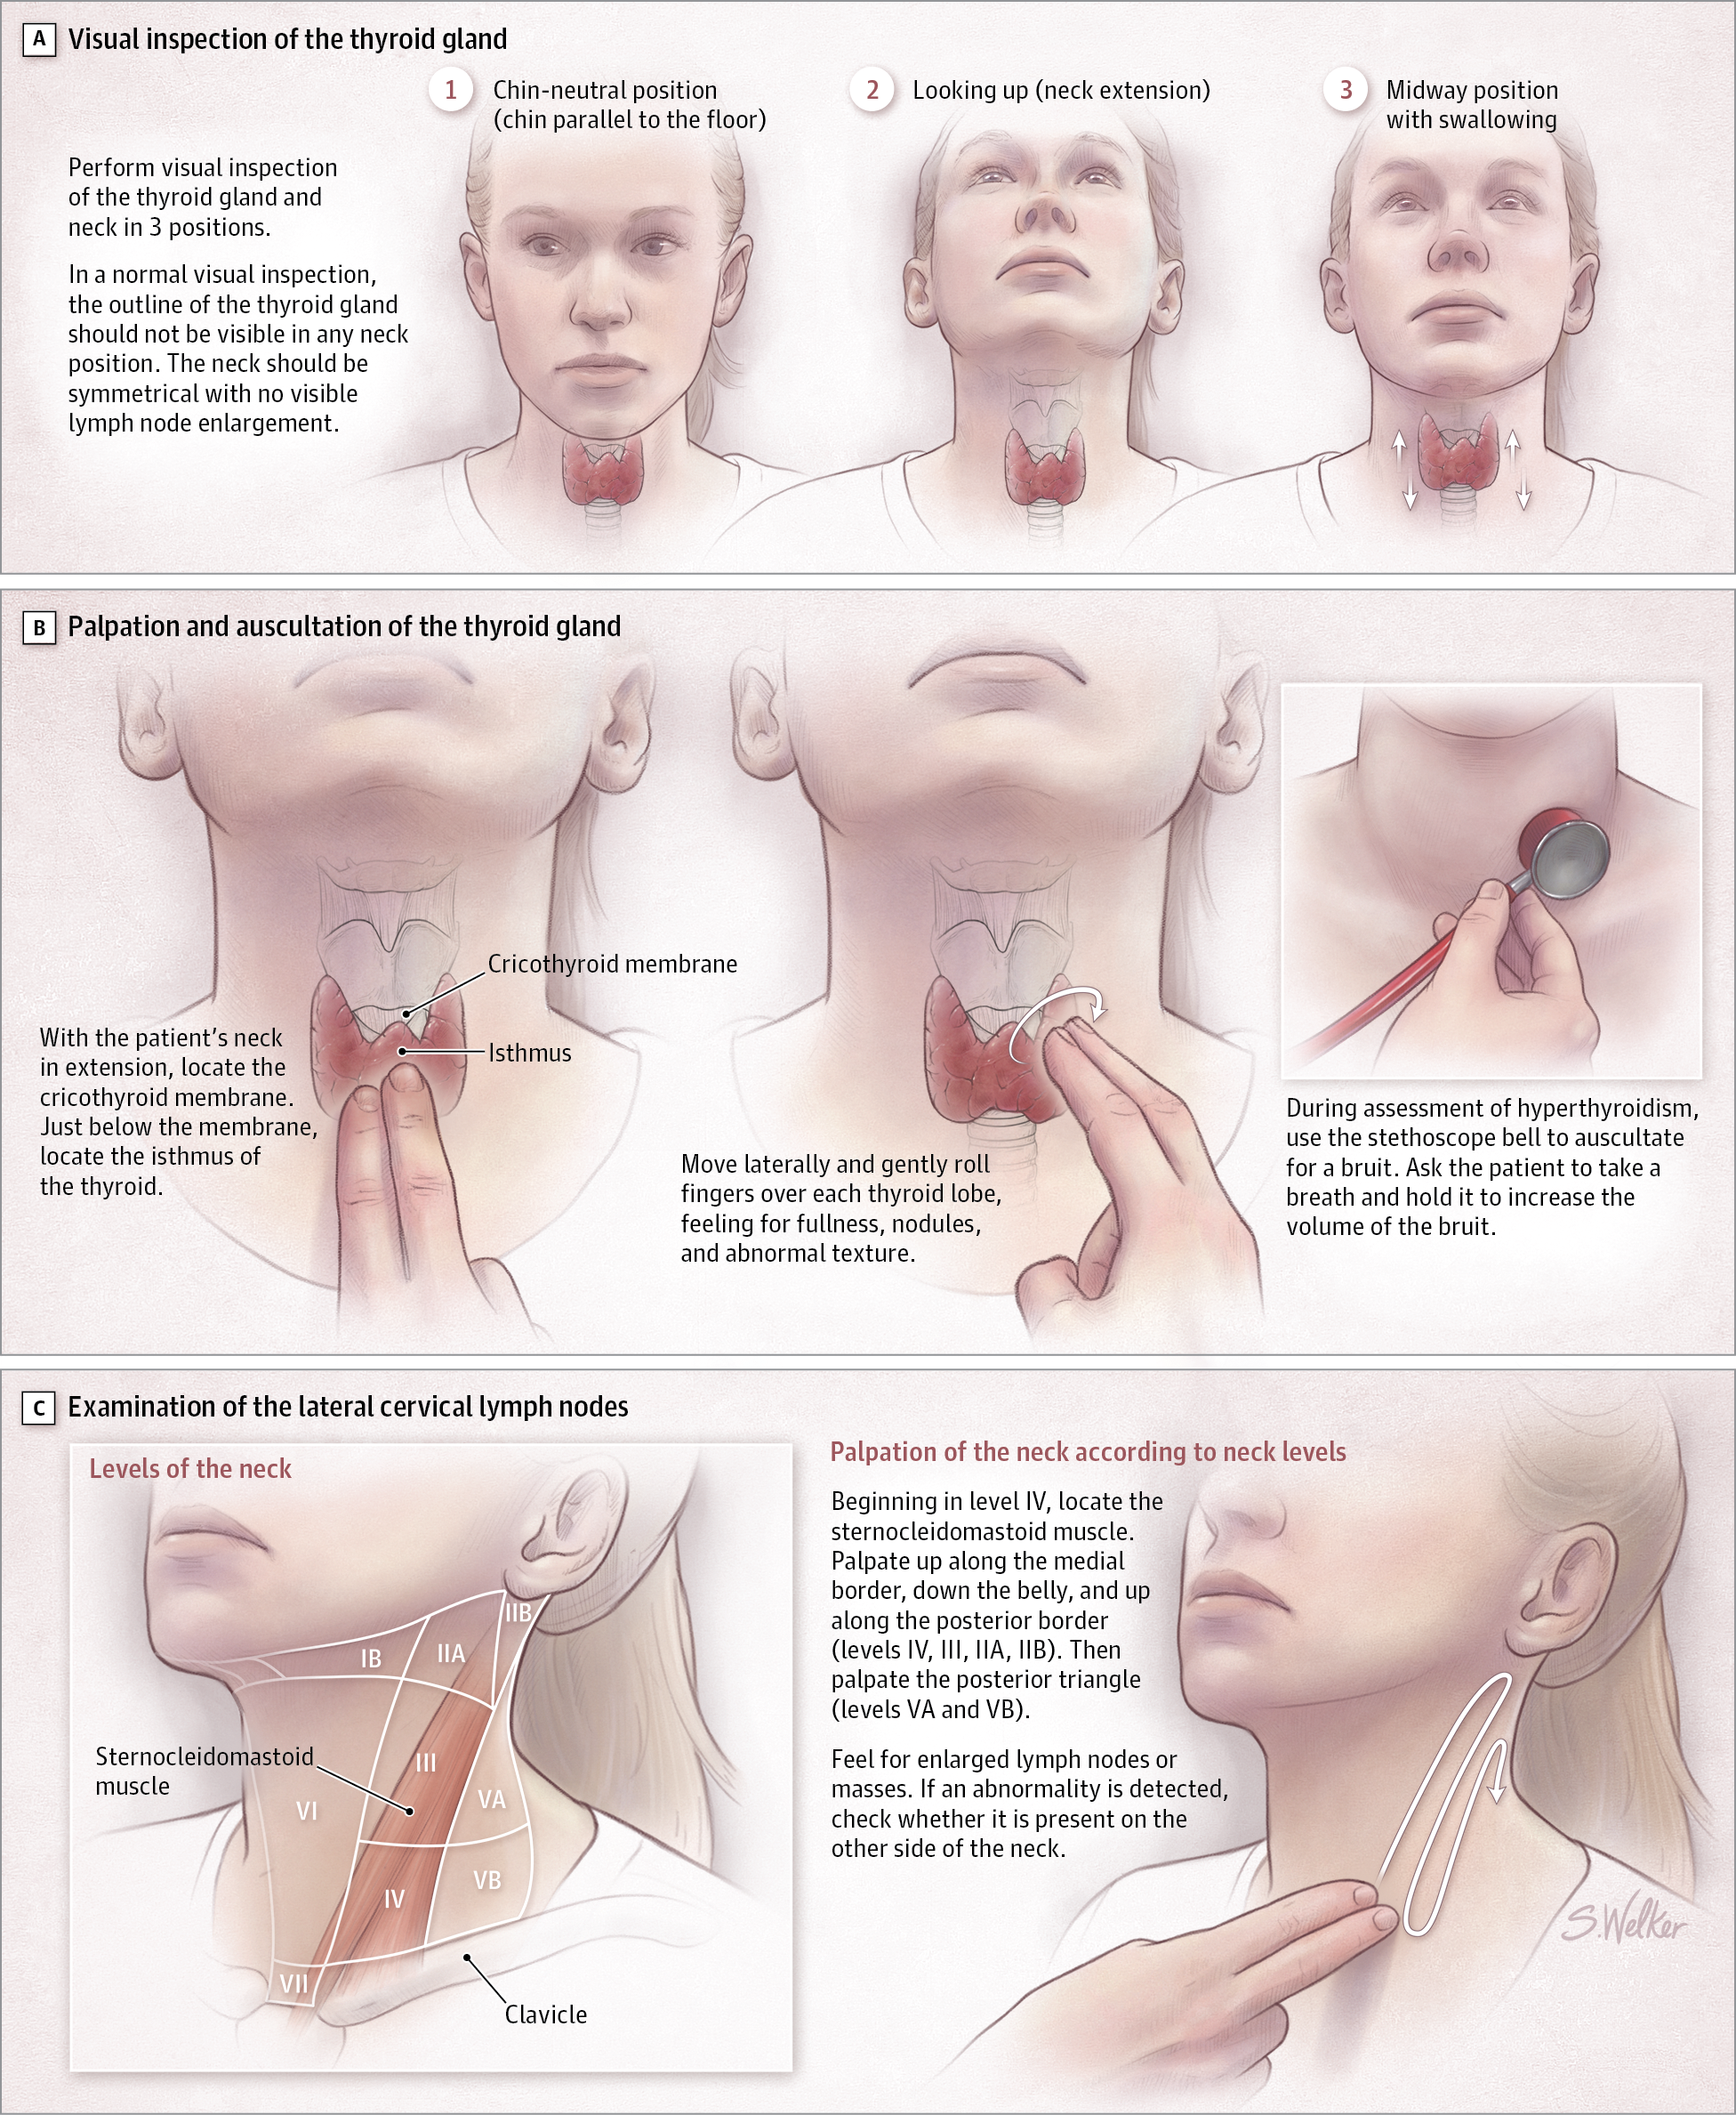
Thyroid Exam
Hanley et al, JAMA Pediatrics, 2017
Notes:
By doing a lot of thyroid exams, pick up the gland that feels different.
Can use thumbs from front. Can also examine from behind, use middle and index fingers

Slide 5
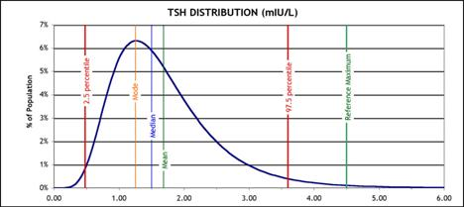
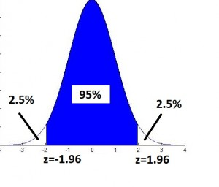
Thyroid Test Norms
Reference range usually based on the central 95% of values seen in apparently healthy individuals
For adults, TSH reference range:
  LL ~0.4-0.5 mU/L
  UL ~4.5-5.5 mU/L (Controversy around ULN)
  Data complicated by differing assays/methods and differing study populations
Normal Distribution

Slide 6
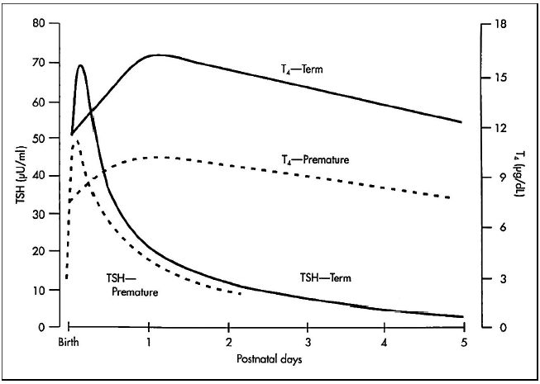
Thyroid Function in the Newborn
Term infant vs premature
TSH surge =
Abrupt rise in the TSH within 30 minutes of delivery, reaching concentrations as high as 60 to 70 mU/L (term)
TSH

Slide 7
TSH in Children: What’s Normal?
AGE | TSH RANGE (μU/mL) | TSH MEAN
Prem 26-32 wk, DOL 3-4 | 0.8-6.9 | 2.3
Full Term Newborn | Surge to 25-160 in 15-60 hours
Full Term, DOL 4 | 1.3-16 | 4.9
Full Term, 1-11 mos | 0.9-7.7 | 2.9
Prepubertal Children | 0.6-5.5 | 1.9
Pubertal Children and Adults | 0.5-4.8 | 1.6
Adapted from www.Esoterix.com http://www.esoterix.com/sites/default/files/imce/uploads/Endo%20Expected%20Values.pdf
Notes:
See how the TSH mean trends down over time as kids reach puberty in adulthood. TSH higher in infancy and trends down over time.
Often labs still use adult reference ranges and then “flags” normal results as abnormal

Slide 8
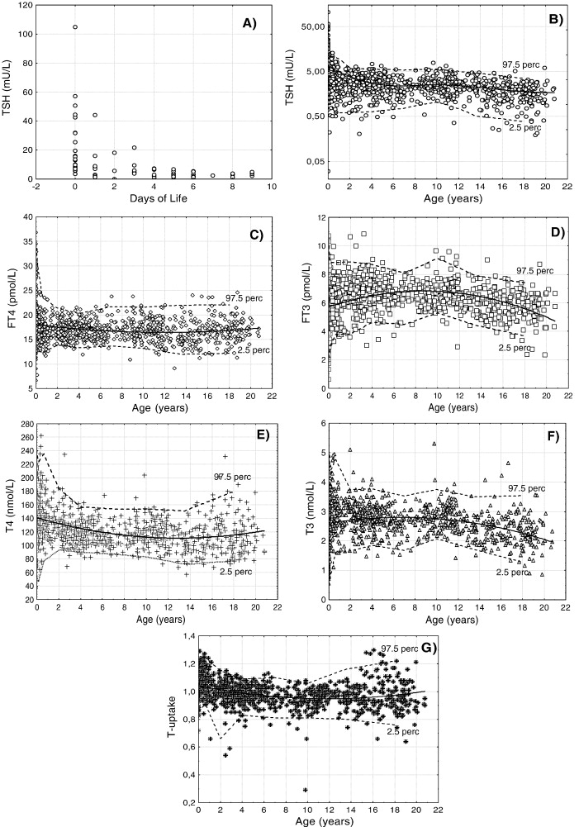
TFTs in Childhood
Study of 1000 children from birth to 20
  “TSH is the most robust diagnostic parameter to evaluate thyroid function in children.”
Caveat: Central hypothyroidism
  Free T4 levels show negligible variations between 3 months and adulthood
  Total T3 runs higher in children than adults
Kratzsch, et al. Clinical Biochem. 2008;41: 1091-1098
Notes:
Central hypothyroidism may occur due to abnormal development of the hypothalamus or pituitary glands (may occur as part of multiple pituitary hormone deficiencies), trauma, a tumor, or treatment for a tumor (surgery, radiation). Central hypothyroidism may be inherited, and boys and girls are affected equally.

Slide 9
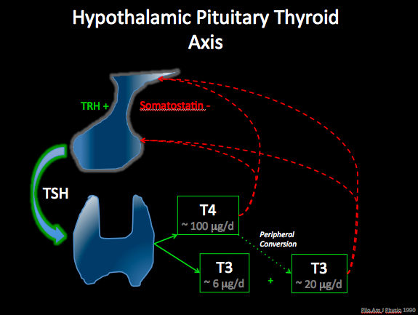
TSH = thyroid stimulating hormone
TRH = thyroid releasing hormone
Thyroid hormones (TH) = T4, T3
0.04% T4 circulates unbound (= free T4 = fT4)
3 main proteins:
1) TBG (thyroxine binding globulin)
2) Pre-albumin
3) Albumin
  Serum Total T4, T3 = “circulating storage pool” of TH
  Free T4 = unbound T4: “active” hormone, available for cell uptake/interaction with nuclear receptors
  Assays:
  Total T4 assays (RIA, chemiluminetric, etc) measure bound and unbound hormone
  Free T4 results are estimates (even when “direct” assay) and include some bound T4
Notes:
Endocrine feedback loops are a simple, but elegant system
Conversion of T4 to T3 involves the deiodination of T4

Slide 10
Interpretation of Thyroid Function Tests
Disorder | TSH level | T4 level | T3 level | Comments
Primary hypothyroidism | High | Low |  | -Assess for goiter on exam -Check for elevated anti-Tg and anti-TPO antibodies
Subclinical hypothyroidism | High | Normal |  | -Assess for goiter on exam -Check for elevated anti-Tg and anti-TPO antibodies
Central hypothyroidism | Low OR normal | Low |  | -Evaluate for other pituitary hormone deficiencies -Consider CNS imaging
Thyroid binding globulin (TBG) deficiency | Normal | Low |  | -Normal free T4 -Males (X-linked)
Hanley et al, JAMA Pediatrics, 2017
Notes:
T3 level not typically measured in patients with hypothyroidism

Slide 11
Interpretation of Thyroid Function Tests
Disorder | TSH level | T4 level | T3 level | Comments
Prematurity | Low or normal | Low |  | Treatment controversial
Hyperthyroidism | Low | High | High | -May have elevated T3/T4 ratio -High Thyroid Stimulating Immunoglobulin (TSI) level or TSH receptor antibody (TRAb) levels
Resistance to Thyroid Hormone | “Inappropriately” Normal | High | High | -Goiter; ADHD behavior
Oral Contraceptives | Normal | High |  | -Normal free T4
Hanley et al, JAMA Pediatrics, 2017
Notes:
Prematurity: hypothyroxinemia of prematurity reflexts immaturity of the HPT axis; sick euthyroid syndrome or a reflection of the stress and illness of the infant; unclear benefit to treat with levothyroxine

Slide 12
Caveats in TSH Measurement
TSH falsely increased by Heterophile Abs, Rheumatoid Factor
Biotin falsely decreases TSH (ask about supplement use)
TSH Range changes in acutely ill euthyroid patients due to cortisol, dopamine, cytokines, etc.
  Only 50% of acutely ill pts with TSH>20 mU/L were actually found to have thyroid disease
Spencer C, et al. Clin Chem 1987;33:1391-6.
Attia J, et al. Arch Intern Med 1999;159:658-65.

Slide 13
Caveats in Thyroid Hormone Measurement
Alterations in binding protein levels (TBG, albumin, transthyretin) affect Total T4 and T3 levels
  Thyroxine binding globulin (TBG)
    Both Total T4 and T3 affected
    Increased by estrogen/OCPs, opiates, pregnancy, hepatitis
    Decreased by androgens, glucocorticoids, nephrotic syndrome, malnutrition
  Acute illness (also affects Free T4 levels)
  Familial dysalbuminemic hyperthyroxinemia – increased total T4, normal T3
Alterations in binding affinity of hormone to binding protein
  Medications: Phenytoin, carbamazepine – decreased Total and Free T4/T3
Nutrients can affect thyroid function
  Iodide, iron, selenium, Vitamin A, Zinc
Notes:
Lithium, amiodarone- other medications that impact thyroid function. Also iodine-containing products (anti-septics, betadine, IV contrast) can cause thyroid abnormalities in the short term
Iodine deficiency remains most common cause of hypothyroidism worldwide. Salt has been iodized in the USA since 1924

Slide 14
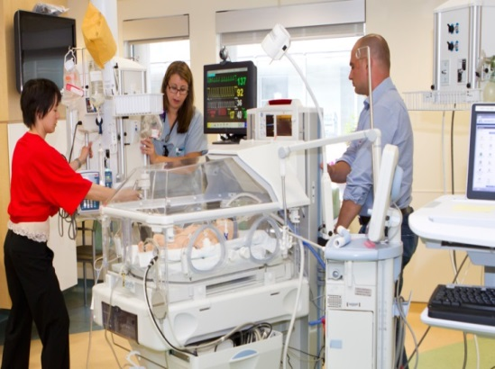
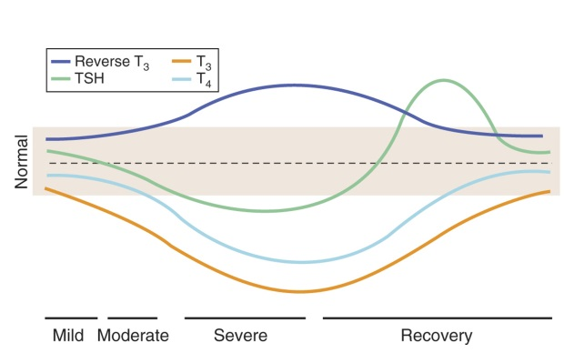
Thyroid Hormone Secretion is Suppressed in Illness →
Non-thyroidal illness (“Sick Euthyroid Syndrome, ” “Low T3 Syndrome”)
Critical Illness
Low T3
Increased reverse T3 (rT3)
Low/normal T4
Low/normal TSH
Adaptive?
Increased catabolism
Increased energy expenditure
Hyperglycemia
Muscle loss
http://ueu.co/md-consult-books-goldman-cecil-medicine-physiology/
Notes:
The overall effect of critical illness on thyroid function is suppression and these effects tend to increase as illness progresses
Reverse T3- a certain percentage of T3 gets inactivated normally, and in times of illness more gets to converted to inactive form
NTIS is characterized most commonly by a low T3 and an increased reverse T3, and as you move into the chronic phase of illness, a low/normal T4 and TSH
The fact that increased catabolism, increased energy expenditure, hyperglycemia, and muscle loss are often associated with critical illness has led to the hypothesis that these changes are potentially an adaptive response designed to reverse this catabolic process

Slide 15
Subclinical Hypothyroidism (SCH)
Definition: Elevated TSH with normal TT4/FT4
Definition varies: TSH 5-10 vs >10 uIU/mL
Prevalence in children ~2% (range 1.7-9.5%)
Most do NOT have symptoms
~70 % show decline in TSH to nl
~25% TSH remains 5-10 mIU/L
0-12.5% progress to overt hypothyroidism
Bona G, et al. J Clin Res Pediatr Endocrinol. 2013 March; 5(Suppl 1): 23–28.
Lazarus J, et al. Eur Thyroid J. 2014;3(2):76-94

Slide 16
Causes of Subclinical Hypothyroidism
Autoimmune thyroiditis (Hashimoto)
Lab/Analytic Issue
Obesity
Recovery phase of euthyroid sick syndrome
Irregular sleep patterns; mood disorder/depression
Therapeutic radiation (esp. in <9 yrs)
Anatomic abnormalities of thyroid gland
Genetic defects causing (mild) dyshormonogenesis
Lazarus J, et al. Eur Thyroid J. 2014;3(2):76-94

Slide 17
Outcomes of Subclinical Hypothyroidism (SCH)
Minimal data in children <3 yrs
Most studies of children > 3yrs show no detriment in growth, bone maturation, cognitive fxn, BMI
No difference over time between children with SCH that persists vs those whose resolves in 2 yrs
Growth, bone maturation, BMI also not different after 3 yrs of no treatment for SCH
Lazarus J, et al. Eur Thyroid J. 2014;3(2):76-94
Wasniewska M, et al. Eur J Endocrinol. 2009;160:417-421

Slide 18
Subclinical Hypothyroidism
Treat if…
-Slightly abnormal NBS→ Infant >1 mo with TSH >5
-Child with TSH >10 mIU/L*
-Clinical signs or symptoms of impaired thyroid function or goiter
-Subclinical hypothyroidism associated with other chronic diseases
*Threshold to treat may be lower based on clinical context
Adapted from Bona G, et al. J Clin Res Pediatr Endocrinol. 2013 March; 5(Suppl 1): 23–28.

Slide 19
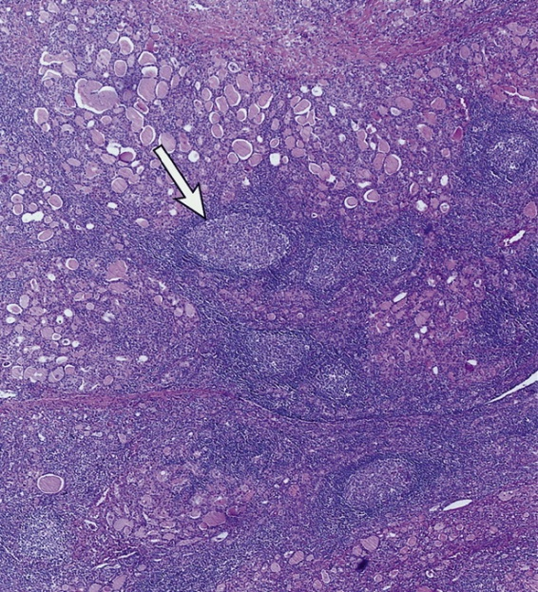
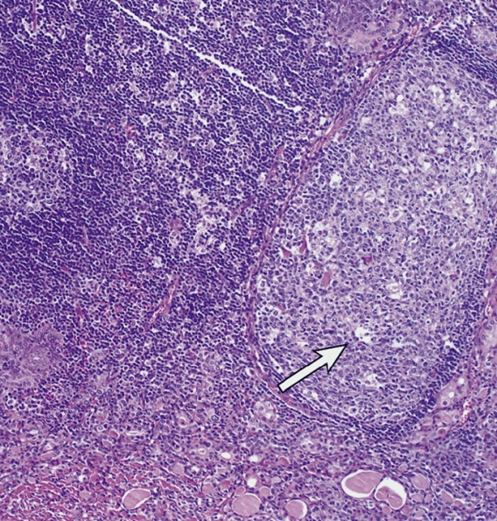
Chronic Autoimmune Thyroiditis aka Hashimoto Thyroiditis
Most common…
  Thyroid disorder in iodine sufficient areas
  Etiology for 1º hypo
  Autoimmune disease
Associated with
  + Family Hx
  4:1 F:M predominance
  TPO, Tg Abs
  Heterogeneity by US
  Populations at increased risk
    Turner Syndrome
    Down Syndrome
    Type 1 Diabetes (~25% with +antibodies)
  Not all with Hashimoto are hypothyroid!
Atrophic
Notes:
50% have autoimmune history in family

Slide 20
Hashimoto Thyroiditis
Our General Approach…
Confirm diagnosis with positive antibodies
  Thyroid peroxidase (TPO)
  Anti-thyroglobulin (Tg)
20-30% become hypothyroid over time
Thyroid Ab titers do not predict thyroid function → no need to repeat/trend
Follow serial TSH, FT4 q 6 mos while growing
Treat if TSH>8 uIU/mL
Call if any overt hypothyroidism sxs:
Fatigue/exercise intolerance
Weight gain
Constipation
Sparse, coarse, dry hair
Coarse, dry, thickened skin
Cold intolerance
Muscle cramps
Hoarse voice, slow speech
Droopy eyelids, puffy/swollen face
Goiter
Menstrual irregularities
Notes:
Antibodies are not functional- just a marker of inflammation

Slide 21
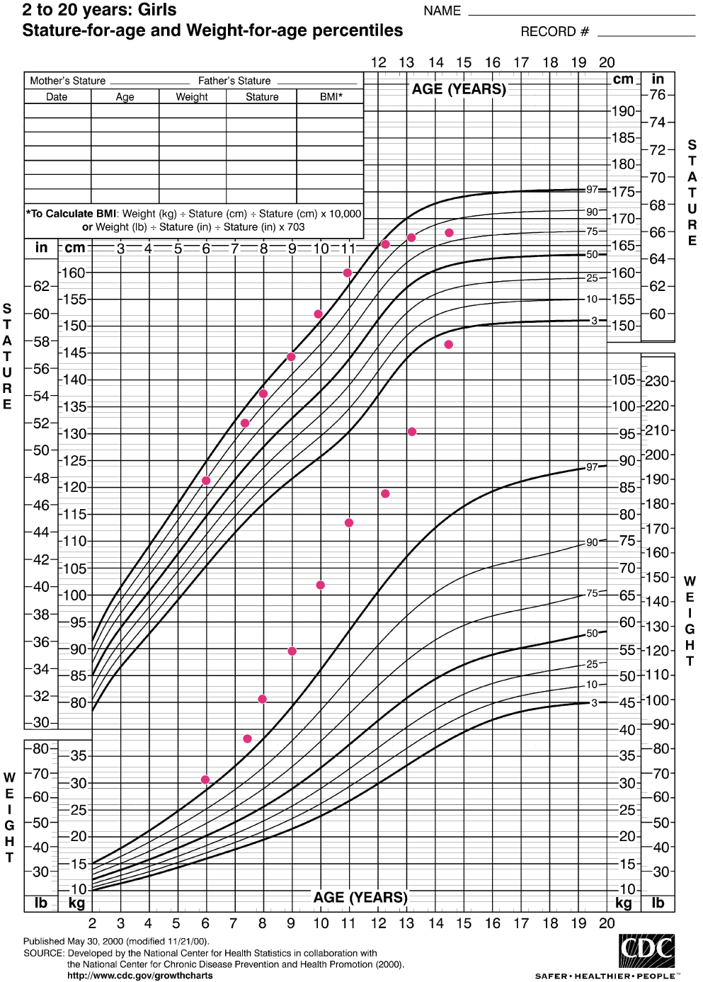
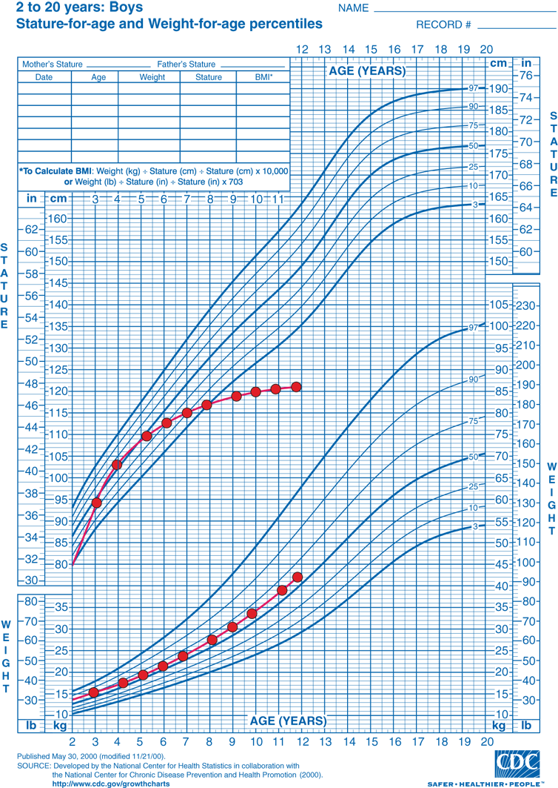
TFTs in Children with Obesity
Pediatric Endocrine Society Obesity Prevention and Treatment Guidelines
(Styne et al, JCEM, 2017):
“We recommend against routine laboratory evaluations for endocrine etiologies of pediatric obesity [including hypothyroidism and growth hormone deficiency] unless the patient’s stature and/or height velocity are attenuated (assessed in relationship to genetic/familial potential and pubertal stage).”
Notes:
Another case where TSH can be mildly elevated is with obesity
Hypothyroidism is very rarely the cause of being overweight or obese. Despite this reality and recommendation against routine TSH screening in the most recent obesity guidelines, medical providers often order thyroid function tests as part of the routine screening in overweight patients—still up for debate.

Slide 22
TFTs in Children with Obesity
TSH values tend to run higher
  Up to 25% may have mild elevation in TSH >4-10 mIU/L
  T4 levels normal, T3 at upper limits normal
Adaptive vs true thyroid dysfunction?
  Autoimmune thyroiditis relatively infrequent (<7%)
  Weight loss → decrease in TSH, T4, and T3
Treatment with levothyroxine (Synthroid)
  No placebo-controlled trials
  TSH will normalize, but…no effect on weight, BMI, growth, or lipids
Pacifico L, et al. Clinica Chemica Acta. 2012:413(3-4);396-405.
Reinehr T, et al. JCEM, 2006;91:3088-3091.
Notes:
Hypothyroidism is very rarely the cause of being overweight or obese. In other words, it is much more common for excess weight to lead to a mild increase in TSH rather than a mild increase in TSH to result in a significant increase in weight.

Slide 23
Subclinical Hyperthyroidism
Definition: Mild TSH suppression, normal free T4, T3
Patients usually asymptomatic; Atrial Fibrillation not an issue for kids
Few pediatric data; prevalence not known
Causes:
  Normal variant
  Excessive thyroid hormone replacement in hypothyroidism
  Hashimoto Thyroiditis
  Autonomously Functioning Nodule (may have variable elevations in TH levels, especially T3)
AversaT, et al. J Endocrinol Invest. 2014;37(3):303-308.

Slide 24
Approach to
Subclinical Hyperthyroidism
Draw Ab studies (TPO, Anti-Tg, TSI, TRAb)
If TH levels (T3 or FT4) elevated, consider Autonomously Functioning Nodule
Anti-thyroid drugs (methimazole) generally NOT recommended for subclinical hyperthyroidism
Monitor TFTs q 3-6 months
Call if overt symptoms of thyrotoxicosis:
Exercise intolerance
Palpitations, tachycardia
Tremor, anxiety, irritability
Graves’ ophthalmopathy
Fatigue, poor/restless sleep
Increased appetite +/- weight loss
Increased frequency BM/urination
Heat intolerance
Poor school performance, difficulty concentrating, “ADHD”, hyperactivity
Goiter
Menstrual irregularities
Notes:
TSH receptor antibody- TRAb has two components- the thyroid stimulating immunoglobulin (TSI) and inhibitory immunoglobulin (TBII)
Monitor more frequently if TSI positive indicating Graves’ disease

Slide 25

Normal or High TSH with High Thyroid Hormone Levels
Differential:
  If patient on levothyroxine, assess compliance
  Resistance to Thyroid Hormone (RTH)
  TSH-secreting adenoma
  Transient, due to Non-thyroidal Illness (NTI)
  SE of Amiodarone
  Lab error → repeat TFTs in ~2 weeks
    If resolved = NTI
    If still abnormal, repeat in different lab/using alternate assay
    If still abnormal, work up to determine RTH vs TSH adenoma

Slide 26
Key Points
Avoid drawing TFTs during acute illness
If TFTs are abnormal, consider confounding factors: clinical scenario (e.g. obesity, chronic illness, genetic syndrome), assay interference, medications, binding protein abnormality
Subclinical hypothyroidism rarely progresses to overt hypothyroidism (and not rapidly)
Repeating TSH and free T4 is often the most reasonable course of action
  Add anti-TPO and anti-Tg antibodies if concern for hypothyroidism
  Add total T3 and TSI/TRAb if concerned for hyperthyroidism/Graves’ disease

Slide 27

CASE 1

Slide 28
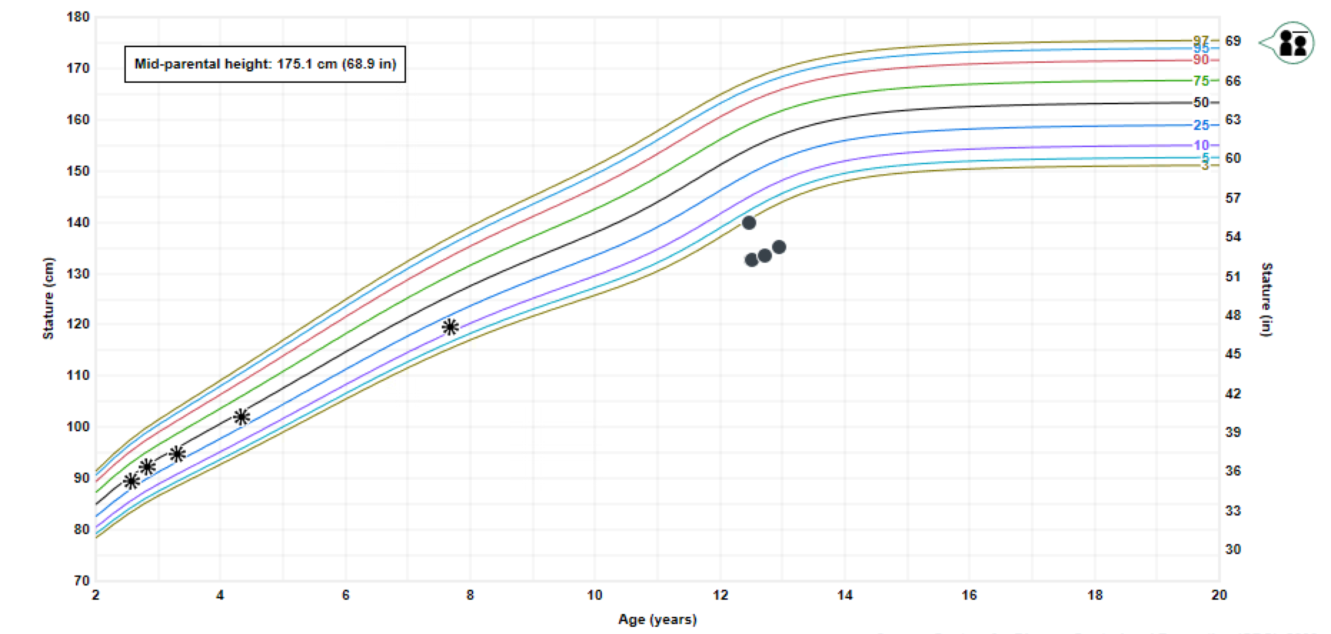
12yo female with short stature
HPI
History of NF1
MRI 2015 “fullness of the pituitary”
Growth deceleration
  Height 14%ile (age 7) to < 1 %ile (age 12)
Stalled puberty:
  Menarche age 10yo
  Thelarche after menarche → then stopped progressing
ROS +headaches and decreased energy
Exam: Tanner stage Breasts 2-3, Pubic hair 1. Thyroid not enlarged
Growth records obtained
Notes:
Additional ROS negative for polyuria/polydipsia, galactorrhea

Slide 29
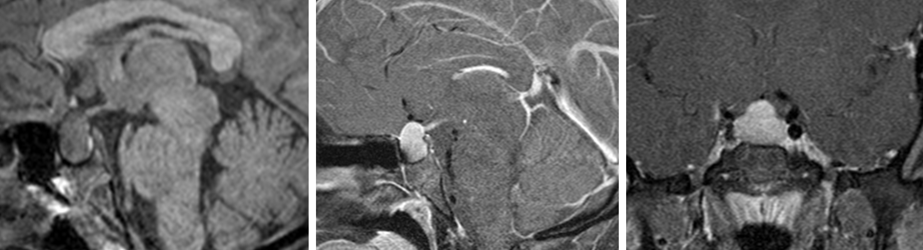
Repeat Brain/Pituitary MRI showed sellar mass
T1 sag T1 sag + C T1 cor + C
There is interval enlargement of the homogeneously enhancing sellar mass with increased suprasellar extension measuring approximately 11 x 21 x 19 mm (AP x TR x CC).
Referred to Neuro-oncology and Neurosurgery
Notes:
Dr. Shekdar

Slide 30
Initial Labs
Component Latest Ref Rng & Units | 4/2/2019
IGF-1/Somatomedin-C ng/mL | 107
IGF-1 Z-Score for Tanner 1 | -2.1
IGF-1 Z-Score for Tanner 2 | -2.2
IGF-1 Z-Score for Tanner 3 | -3.1
IGF-1 Z-Score for Tanner 4, 5 | -3.8
T3 Uptake, S 24.0 - 35.0 % | 24.0
Thyroxine (Total T4) 4.7 - 9.9 mcg/dL | <3.0 (L)
Alpha Fetoprotein 0.6 - 5.6 ng/mL | 4.4
Total BHCG mIU/mL | <1.2
Free Thyroxine (Free T4) 1.0 - 1.8 ng/dL | <0.3 (L)
12yo F with decreased linear growth, stalled puberty, fatigue, and pituitary mass
Referred to Endocrinology
What are possible causes of the low TT4, FT4, and IGF-1?
What additional labs would you order?
Notes:
Short stature associated with NF1
Central hypothyroidism and growth hormone deficiency secondary to sellar mass
Primary hypothyroidism

Slide 31
Additional Results
Component Latest Ref Rng & Units | 4/22/2019
Cortisol, Serum Lcms ug/dL | 11
ACTH, Plasma 7.2 - 63.3 pg/mL | 42.5
Luteinizing Hormone (LH) ECL mIU/mL | 0.015
FSH mIU/mL | 9.1
Estradiol, Sensitive pg/mL | 207.9
Prolactin 4.8 - 23.3 ng/mL | 53.9 (H)
TSH 0.450 - 4.500 uIU/mL | 1460 uIU/mL
Free T4 by Dialysis/Mass Spec ng/dL | <0.20
Bone age 11 yrs 0 mos at chronologic age 12 yrs 5 mos
Height (4/2019): 52.24in
Predicted adult height: 57.7in
What is the diagnosis?
What is the treatment?
Notes:
Also did have positive thyroid antibodies (TPO and Tg) for Hashimoto’s thyroiditis,

Slide 32
Diagnosis:
Severe primary acquired hypothyroidism
Most common cause: autoimmune (Hashimoto’s) thyroiditis
Thyroid Exam: diffuse enlargement, irregular cobblestone texture, asymmetry
  May see thyroid atrophy rather than enlargement with severe disease
Ultrasound findings: diffusely enlarged with heterogeneous echotexture
  Hypoechoic micronodules (1-6 mm)
Treatment: Levothyroxine (“start low and go slow”)
  Absorption can be affected by: soy, iron, calcium
Can see pituitary hyperplasia on MRI (usually not ordered)
Notes:
Can also have delayed/puberty or irregular periods (altered blunted LH pulsatility, elevated prolactin)

Slide 33
Diagnosis:
Severe primary acquired hypothyroidism
Decreased and impaired GH secretion
Hypercholesterolemia (↑ LDL), anemia, hyponatremia, elevated liver transaminases
Can present with pseudo-precocious puberty
  Boys: Penile/testicular enlargement with lack of androgen-mediated body hair
  Girls: Menstruation and breast development
  Galactorrhea (TRH stimulates both TSH and prolactin)
  High levels of TSH cross-reacting with FSH receptors (same alpha subunit)
Bone age delay reflects duration of hypothyroidism
Notes:
Can also have delayed/puberty or irregular periods (altered blunted LH pulsatility, elevated prolactin)

Slide 34
CASE 2

Slide 35
HPI
A 6-yo girl presents after tachycardia noted by dentist
Other symptoms:
  Fatigue, behavioral problems, increased frequency of stools
Recently diagnosed with ADHD, started stimulant 1 month ago with no improvement
Exam: Thyroid diffusely enlarged
Labs:
  TSH <0.01
  Elevated FT4
What is the most likely diagnosis?
STATURE
WEIGHT

Slide 36
Differential Diagnosis of Thyrotoxicosis
Graves Disease
Hashitoxicosis/Painless Thyroiditis
Autonomous Hyperfunctioning Nodule
Genetic – e.g. McCune-Albright (somatic GNAS mutation)
Resistance to Thyroid Hormone (germline THRB mutation)
Familial Non-Autoimmune Hyperthyroidism (constitutive activation of TSH-receptor, germline mutation)
Suppurative thyroiditis
Subacute thyroiditis
Drug-induced – e.g. amiodarone
Factitious Hyperthyroidism
Neck Trauma- or Palpation-Induced

Slide 37
Graves Disease
Most common etiology of hyperthyroidism
10-15% of thyroid disorders in children
Prevalence 1 in 5k-10k
Age at diagnosis
  <5% less than 5 yrs
  15% 5-10 yrs
  80% >10 yrs
5:1 F:M

Slide 38
Laboratory Findings – Graves Disease
Suppressed TSH (<0.01 uIU/mL)
Elevated TH levels (T3>T4)
(+) TSH-Receptor Stimulating Abs (TSIg, TBII)
(+/-) TPO and/or Tg Ab
Associated lab abnormalities:
Low WBC
Elevated LFTs
Abnormal lipid profile

Slide 39
Graves Disease Treatment Options in Children
Medical
Definitive Treatment Options
Propylthiouracil (PTU) contraindicated in children due to hepatotoxicity
Methimazole (MMI) SE include rash (common), bone marrow suppression and liver toxicity (rare, severe)
After MMI for 12-24 months, remission rate is 20-30%
Low chance of remission if: large thyroid, young age, more severe lab abnormalities
Surgery
131-Iodine
Notes:
39
Always check CBC and LFTs before starting treatment with methimazole.
Surgery since early 1900s, Medical therapy (methimazole/PTU) and radioactive iodine have been around since the 1940s

Slide 40
Growth chart after methimazole started at age 6.5

Slide 41
CASE 3

Slide 42
Down Syndrome and TFTs
Male diagnosed prenatally with Trisomy 21
Born at 39 weeks
10 days in NICU for pulmonary HTN and feeding difficulties
  2 small VSDs, following with cardiology
  No past surgeries
Referred to Endocrine at age 3 months for TFT abnormalities
Growth at 25%ile on DS growth chart (height + weight)
ROS: Constipation, reflux (on Zantac)
Exam: Trisomy 21 facies, Hypotonia
Receives OT/PT

Slide 43
Down Syndrome and TFTs
Review of thyroid function tests:
  Normal newborn screen; persistent mild TSH elevation
 | 10/10/16 | 10/25/16 | 11/29/2016 | 4/3/2017
Age | 1 mo | 1.5 mos | 2.5 mos | 7 mos
TSH (uIU/mL) | 12.88 | 9.52 | 8.06 | 0.75
Free T4 (ng/dL) | 1.25 | 1.16 | 0.92 | 1.29
Other |  |  |  | Tg Ab neg TPO Ab neg
Started levothyroxine 37.5 mcg daily
Notes:
At 9 month visit, parents reported perhaps slight improvement in constipation, now rolling over

Slide 44
Down Syndrome and TFTs- Another Case
Female with Trisomy 21 diagnosed prenatally
Born at 37 1/7 weeks
  PDA, mild to moderate RV dilation, left aortic arch with aberrant right subclavian artery
  Asymptomatic from CV standpoint
  No past surgeries
Referred to endocrine at age 7 months
Growth 50%ile on DS growth chart

Slide 45
Down Syndrome and TFTs- Another Case
Thyroid function tests:
  Newborn screen normal
 | 9/3/2016 | 9/5/2016 | 9/13/2016 | 1/12/2017 | 6/8/2017
Age | DOL#2 | DOL#4 | 2 weeks | 4 mos | 9 mos
TSH (uIU/mL) | 26.02 | 11.80 | 6.24 | 14.45 | 3.89
Free T4 (ng/dL) | 2.47 | 2.94 | 1.58 | 1.46 | 1.07
  TFTs normalized without treatment

Slide 46
Thyroid Dysfunction in
Children with Down Syndrome
AAP: 4-18% of children with DS with thyroid d/o (CH, SCH, AIT, Graves)
SCH 10x more common in DS (25-60%) than general population
Increased risk for thyroid autoimmunity (HT and Graves), esp. >8 yrs of age
Young children with DS and SCH: ~70% chance TFTs will normalize (if Abs negative)
AAP: TFT screening at 6 and 12 months, then yearly
Bull M and Committee on Genetics. Pediatrics. 2011;128:393-406
King K, et al. Irish J Medical Science. 2013;183:994

Slide 47
SCH in Young Down Syndrome Pts
Catalan DS Foundation Registry
  53 pts < 5yrs with SCH (TSH 5.5-25)
  28M, 25F followed 54 +/- 19 months
  Median age at dx 2.2 yrs (0.3-4.9), med TSH 7.1
  SCH resolved in:
    35/39 untreated pts
    4/14 LT4 treated pts (most had initial TSH>10)
    Most cases resolved between 4-5 yrs of age
    No pt progressed to overt hypothyroidism
Claret C, et al. Pediatr Res 2013;73(5):674-678

Slide 48
Treatment of SCH in DS:
No consensus among guidelines
CON
PRO
Lack of SE with LT4
Possible improved growth, development
Prevent progression to overt hypothyroidism
TSH elevation is often transient
No clear benefit
Risk of progression to overt hypothyroidism overstated
King K, et al. Irish J Medical Science. 2013;183:994

Slide 49
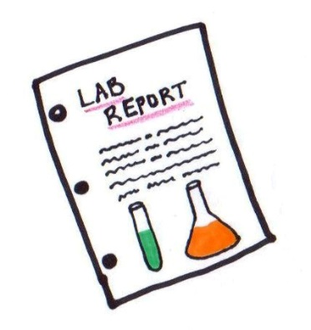
Approach to DS Pt with SCH
Measure TSH and free T4
If TSH elevated, obtain thyroid antibodies (TPO, Tg)
If TSH >5 but <10:
  Consider tx if goiter and/or + Abs and/or low FT4
  Follow clinically and with serial TFTs
If TSH >10, tx with LT4->consider trial off based on clinical course and labs
Adapted from Claret C, et al. Pediatr Res 2013;73(5):674-678

Slide 50
Thank you!
Questions?

