Slide 1
Bruises, Bites and Burns March 9, 2020 Lisa Pavlovic, MD Yale University School of Medicine

Slide 2
Disclosures
The following individuals have no conflicts of interest to disclose relevant to this activity:
Lisa Pavlovic, MD
Gunjan Tiyyagura, MD
Sandra Selzer, MSHQ
Kris Samara
Jessica Runyon

Slide 3
Learning Objectives
Participants will:
Discuss how infants and toddlers are at highest risk for victimization.
Review the importance of understanding a child’s developmental ability in the setting of a burn
Identify different burns and an approach to evaluating them.

Slide 4
Accreditation
This activity has been planned and implemented in accordance with the accreditation requirements and policies of the Accreditation Council for Continuing Medical Education (ACCME) through the joint providership of the New Jersey of Academy of Family Physicians and Hezekiah Beardsley Connecticut Chapter of the American Academy of Pediatrics and the Yale University School of Medicine. The New Jersey Academy of Family Physicians is accredited by the ACCME to provide continuing medical education for physicians.
The New Jersey Academy of Family Physicians designates this live activity for a maximum of 1.0 AMA PRA Category 1 Credit(s)™.
Physicians should claim only the credit commensurate with the extent of their participation in the activity.

Slide 5
Most burns are accidental
Estimates of the frequency of abuse as the cause of burns range from 0-19.5% .*
Thermal burns are most common (e.g., scalds, contact with a hot object or open flame, radiation injury).
Scalds are the most common of these.
* Rosenberg 1989

Slide 6
Classification of burns
Superficial (first degree)
Partial thickness (second degree)
Full thickness (third degree)

Slide 7
Scald burns
Scald burns can be further classified into:
Immersion burns
Flowing liquid burns
Splash burns
Splatter burns
Scalds can be accidental or abusive

Slide 8
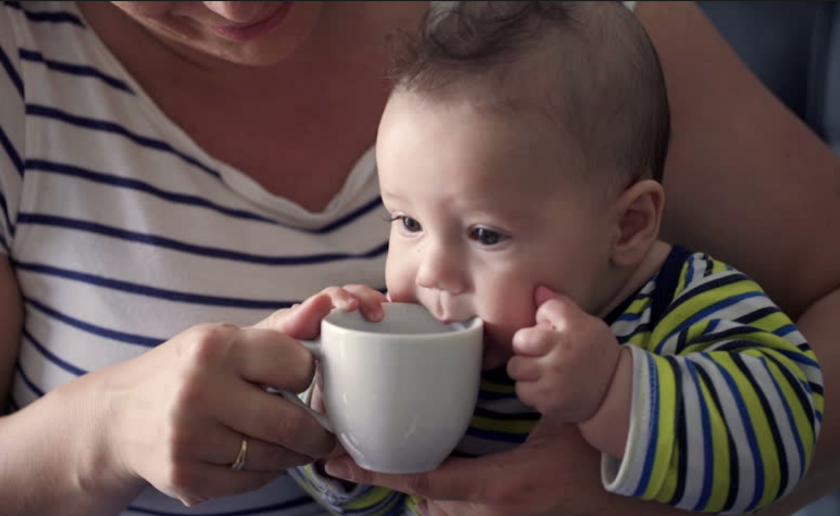
Commonplace accidental scald burns
Hot liquids in the kitchen, on the table, in mugs
Sinks/tubs when the temperature is set too high

Slide 9
Hot water temperature is key
Depending on the temperature, hot water can badly burn skin in as little as less than one second (150 degrees).
Measurement of water temperature can be crucial.

Slide 10
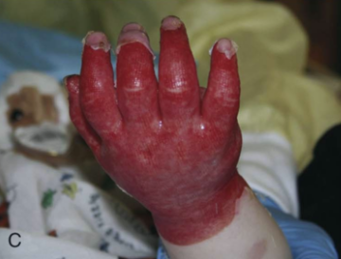
Immersion burns
Can have sharp lines of demarcation.
Can be accidental or inflicted.
Key is an understanding of a child’s developmental ability.
Babies as young as 10 months can get into the tub (even when not yet walking).
Scene investigation is crucial.

Slide 11
Distinguishing between accidental and abusive water burns
The history is critical.
Pay special attention to the developmental ability of the child and the details of the caregiver history.
Patterns matter: symmetrical and sharp borders versus asymmetry, irregular borders and splash marks.
Locations matter: hands, feet, buttocks and perineum are more worrisome.

Slide 12
Splash and splatter burns
Can be due to liquids other than water than be much hotter (e.g., grease, wax).
Can be altered based on clothing.
Usually diminish in severity as the liquid flows and cools.
Hot grease from a frying pan

Slide 13
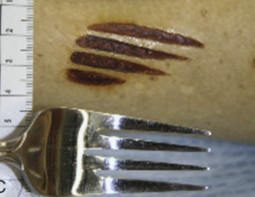
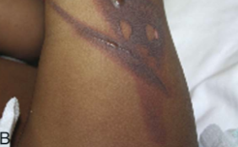
Contact burns
Heaters
Irons
Hair styling tools
Lighters
Cigarettes
Heated up metal objects (e.g., forks, spatulas)
May be accidental or inflicted

Slide 14
Flame burns
Can occur when clothing catches fire.
Can be abusive (i.e., hands or other body parts held over an open flame).
Burns sustained after the child’s shirt was ignited by a lighter

Slide 15
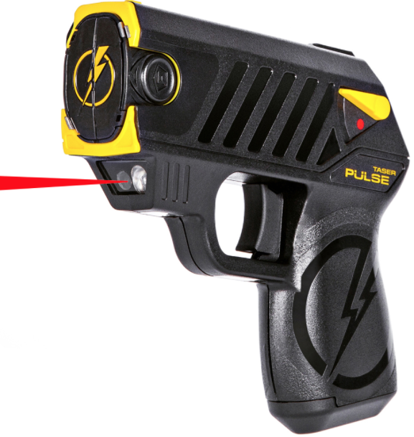
Electrical burns
Biting an electrical cord, playing with outlets
Stun guns

Slide 16
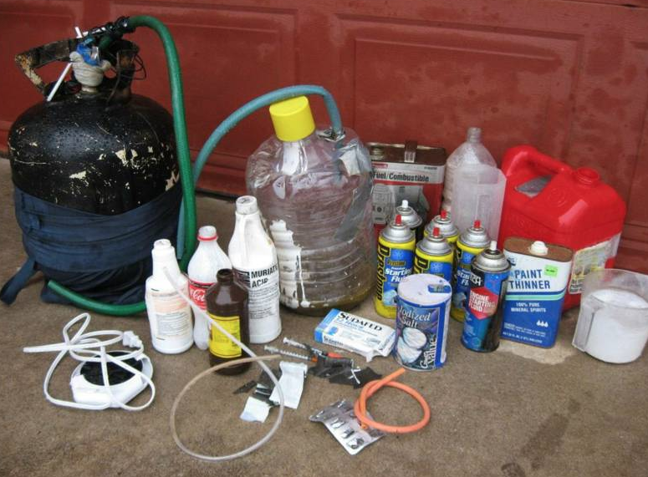
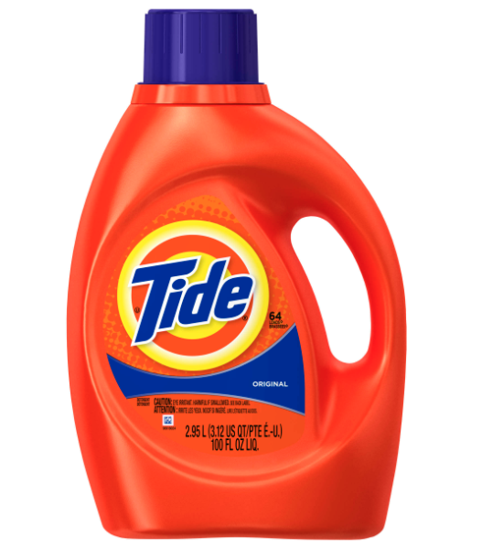
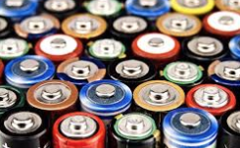
Chemical burns
Household products
Chemicals used in manufacturing drugs (methamphetamine)
Battery fluid
May be accidental, intentional or due to neglectful supervision

Slide 17
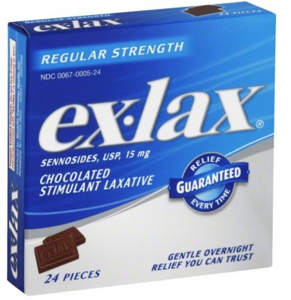
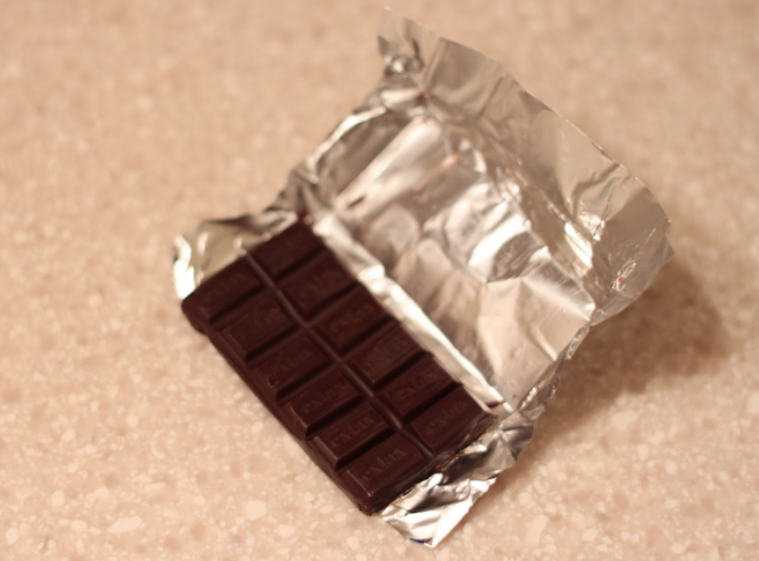
Laxative dermatitis
Can be confused with immersion injury to the buttocks.
Occurs after laxative ingestion.
First described by our own Dr. Leventhal.

Slide 18
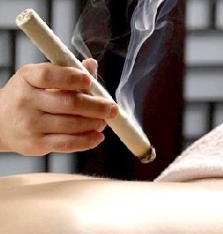
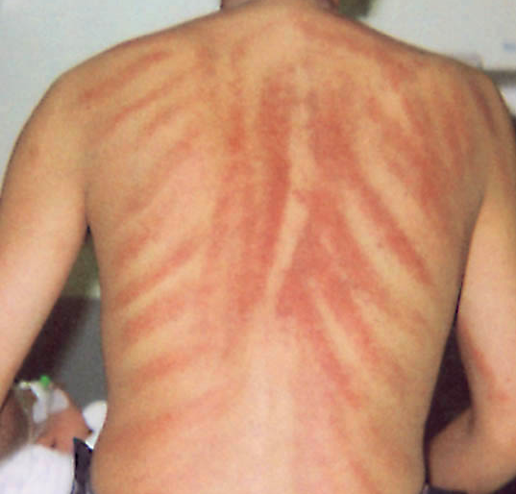
Cultural healing practices can mimic burns
Cupping
Moxibustion
Cao gio (i.e., coin rubbing)

Slide 19
Phytophotodermatitis
“Lime disease”
Reaction to certain plants (juice or sap) plus sunshine

Slide 20
Approach to burns
History is key:
Developmental ability of the child.
History inconsistent with observed injury.
Changing stories.
Unexplained delay in seeking care.
Scene investigation is likely to be crucial.

Slide 21
Burns key points
Burns may be accidental or inflicted and may also be due to supervisory neglect.
The history and careful scene investigation are likely to be most useful.
Don’t forget common burn mimics.

Slide 22
Child Abuse Centers of Excellence Contact Info
203-688-2468
Region 1 (Norwalk, Bridgeport)
Region 2 (New Haven, Milford)
Middletown, Danbury, Meriden
860-837-5890
Region 4 (Hartford, Manchester)
Willimantic, Norwich, Waterbury and New Britain
We are here to help!

Slide 23
Q&A

